Slide 1
Science objective B1
Presentation by Carlos Braga
George Mason University

Slide 2
Sci. Obj. Set B:
Applying STEREO Observations Toward Evaluating Off-L1 Location Space Weather Research
Science Objective B1:
How Do Coronal and Heliospheric Observations Obtained within ±60º Longitude of L1 Affect Space Weather Forecast Model Results

Slide 3
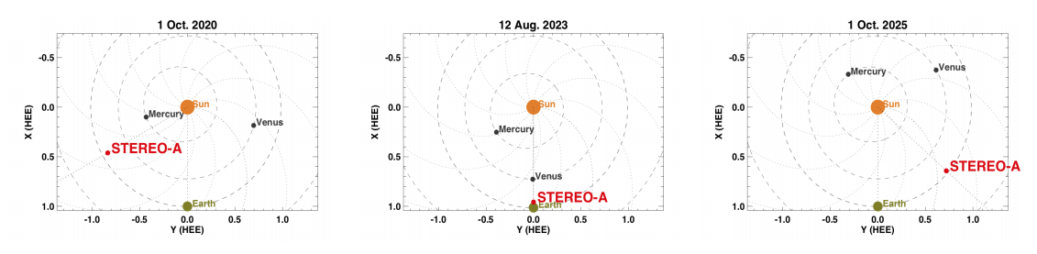
Previous L4/L5 observations:
  November 2009 (ST-B at L5 and ST-A and L4)

Slide 4
Plans
Earth-directed CMEs-> observed by Heliospheric Imagers 1 or 2
Up to 15 degrees from L5
  April 15, 2020, and August 1, 2021
92 CMEs observed by HI-1 (Helcats)
21 ICMEs https://helioforecast.space/icmecat

Slide 5
Plans
Time-of-Arrival (ToA) and Speed-on-Arrival (SoA)
Forecasting B: 3DCORE model
hit/miss perspective (less explored than ToA and SoA) (Vourlidas+ review)

Slide 6
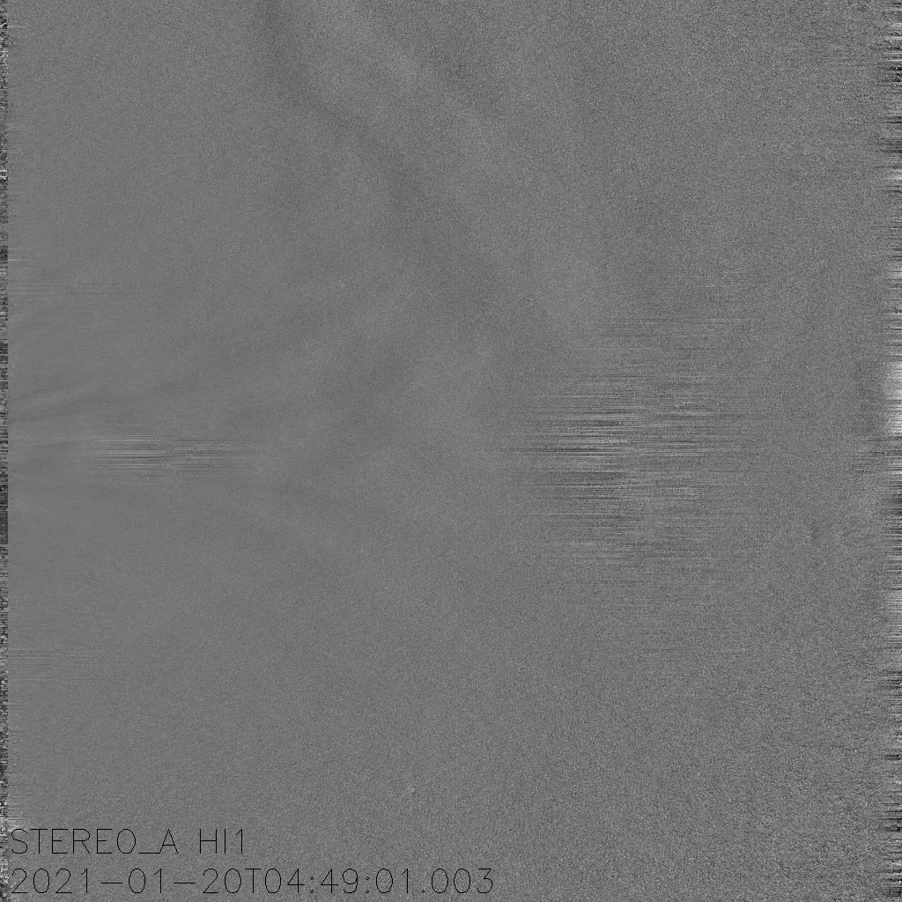

Slide 7
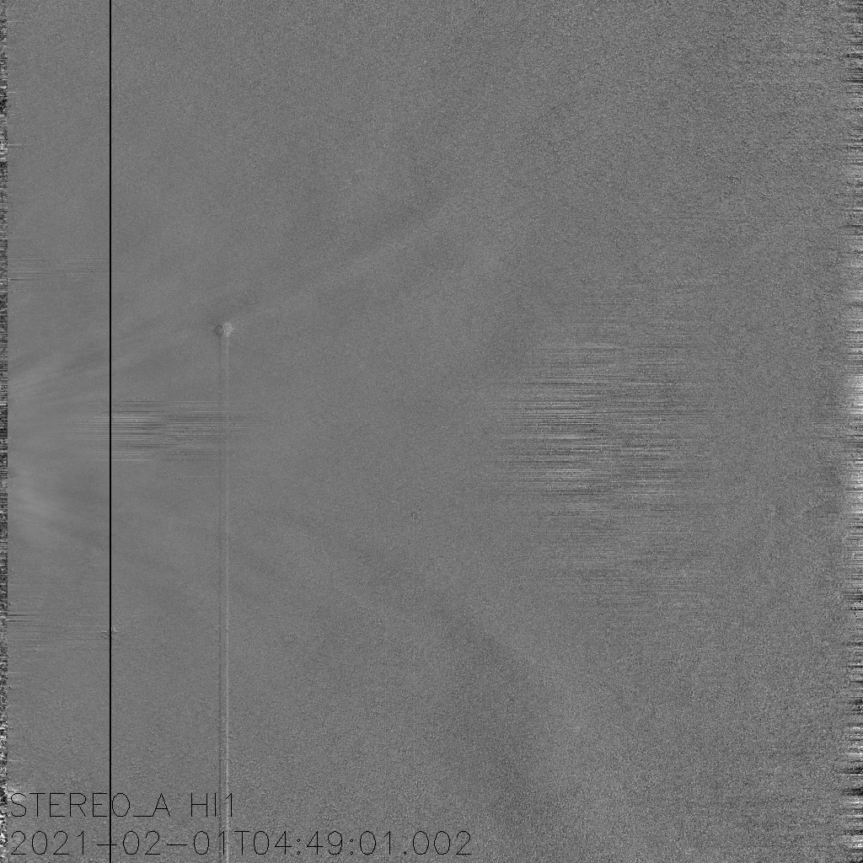

Slide 8
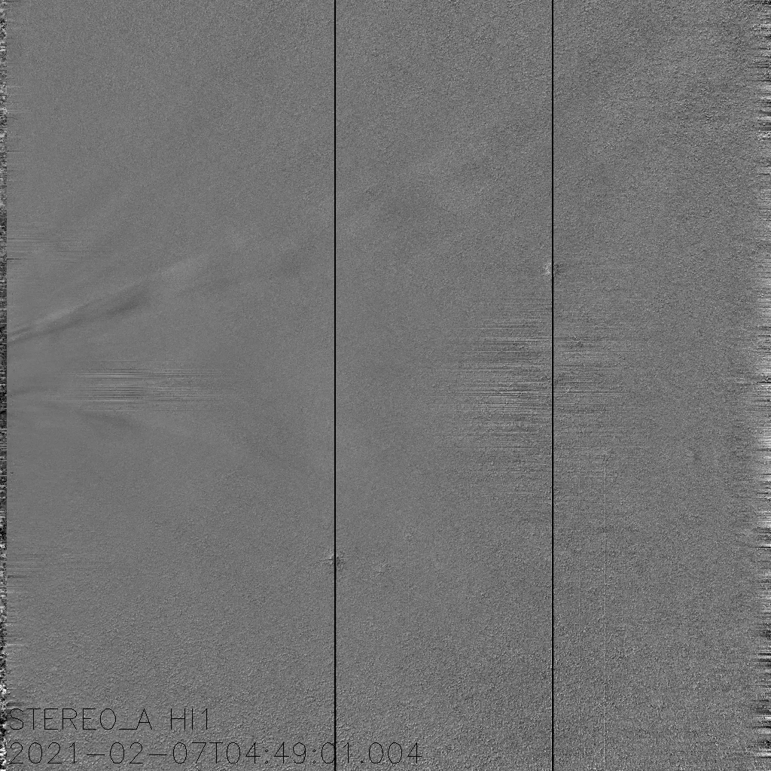

Slide 9
Publications
Paouris, E., Čalogović, J., Dumbović, M. et al. Propagating Conditions and the Time of ICME Arrival: A Comparison of the Effective Acceleration Model with ENLIL and DBEM Models. Sol Phys 296, 12 (2021). https://doi.org/10.1007/s11207-020-01747-4
Lang, M., Witherington, J., Turner, H., Owens, M. J., & Riley, P. (2021). Improving solar wind forecasting using data assimilation. Space Weather, 19, e2020SW002698. https://doi.org/10.1029/2020SW002698
Braga, C. R., Vourlidas, A., Stenborg, G., Dal Lago, A., de Mendonça, R. R. S., & Echer, E. (2020). Predicting the time of arrival of coronal mass ejections at Earth from heliospheric imaging observations. Journal of Geophysical Research: Space Physics, 125, e2020JA027885. https://doi.org/10.1029/2020JA027885
Palmerio, Erika; Nitta, Nariaki V.; Mulligan, Tamitha; Mierla, Marilena; O'Kane, Jennifer; Richardson, Ian G.; Sinha, Suvadip; Srivastava, Nandita; Yardley, Stephanie L.; Zhukov, Andrei N. Investigating Remote-Sensing Techniques to Reveal Stealth Coronal Mass Ejections, Frontiers in Astronomy and Space Sciences, 8, 109, 2021 https://www.frontiersin.org/article/10.3389/fspas.2021.695966
Evangelos Paouris, Angelos Vourlidas, Athanasios Papaioannou, Anastasios Anastasiadis, (2021), Assessing the Projection Correction of Coronal Mass Ejection Speeds on Time-of-Arrival Prediction Performance Using the Effective Acceleration Model, Space Weather, 19, 2, https://doi.org/10.1029/2020sw002617
Zhang, Jie; Temmer, Manuela ; Gopalswamy, Nat ; Malandraki, Olga ; Nitta, Nariaki V. ; Patsourakos, Spiros ; Shen, Fang ; Vršnak, Bojan ; Wang, Yuming ; Webb, David ; Desai, Mihir I. ; Dissauer, Karin ; Dresing, Nina ; Dumbović, Mateja ; Feng, Xueshang ; Heinemann, Stephan G. ; Laurenza, Monica ; Lugaz, Noé ; Zhuang, Bin Earth-affecting solar transients: a review of progresses in solar cycle 24 Progress in Earth and Planetary Science, Volume 8, Issue 1, article id.56, 2021, https://doi.org/10.1186/s40645-021-00426-7
E. Asvestari, J. Pomoell, E. Kilpua, S. Good, T. Chatzistergos, M. Temmer, E. Palmerio, S. Poedts and J. Magdalenic Modelling a multi-spacecraft coronal mass ejection encounter with EUHFORIA. Astronomy & Astrophysics, 65, A27, 18 https://doi.org/10.1051/0004-6361/202140315

Slide 10
Articles (probably not sponsored by STEREO)
- Amerstorfer, T., Hinterreiter, J., Reiss, M. A., Möstl, C., Davies, J. A., Bailey, R. L. et al. (2021). Evaluation of CME arrival prediction using ensemble modeling based on heliospheric imaging observations. Space Weather, 19, e2020SW002553. https://doi.org/10.1029/2020SW002553
- Amerstorfer, T., Hinterreiter, J., Reiss, M. A., Möstl, C., Davies, J. A., Bailey, R. L. et al. (2021). Evaluation of CME arrival prediction using ensemble modeling based on heliospheric imaging observations. Space Weather, 19, e2020SW002553. https://doi.org/10.1029/2020SW002553
- Rodriguez, L., Scolini, C., Mierla, M., Zhukov, A. N., & West, M. J. (2020). Space weather monitor at the L5 point: A case study of a CME observed with STEREO B. Space Weather, 18, e2020SW002533. https://doi.org/10.1029/2020SW002533

