Slide 1
Low Mass Coronal Mass Ejections Missed by STEREO A/B or LASCO and Associated ICMEs
H. Xie^{1,2}, O. C. St. Cyr², N. Gopalswamy²
and J. Davila ²
¹CUA
²NASA/GSFC

Slide 2
DATA
COR1 CME preliminary list :
http://cor1.gsfc.nasa.gov/catalog/
LASCO CME Catalogue:
http://cdaw.gsfc.nasa.gov/CME_list/index.html
STEREO image search tool / movie maker :
http://stereo-ssc.nascom.nasa.gov/cgi-bin/images
UCLA ICME list:
http://www-ssc.igpp.ucla.edu/forms/stereo/stereo_level_3.html
STEREO level2 IMPACT magnetic and PLASTIC solar wind Data at UCLA aten.igpp.ucla.edu/forms/stereo/level2_plasma_and_magnetic_field.html
NSSDC OMNI 2 data
http://omniweb.gsfc.nasa.gov/form/dx1.html

Slide 3
OUTLINE
1. Scientific Background:
Thomson scattering; brightness vs. CME longitude
2. Case study: faint CMEs missed by either STA or B (/LASCO) and associated ICMEs.
3. Properties and propagation of faint CMEs.
4. Statistics: CME missing rate of STA/B.

Slide 4
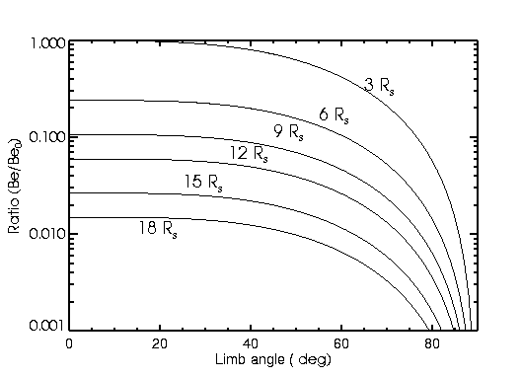
CME Brightness
White-light brightness are from Thomson
scattering of electrons in the corona (Billing, 1960):
B_{tot} = N_{e} × B_{e}(R_{in},φ), where B_{e}(R_{in},φ) is the scatting function for a single electron.
B_{e}/B₀ vs φ at various R_{in}
where, B₀ = B_{e}(R_{in},,φ) at R_{in} = 3 R_{s} & φ = 0.

Slide 5
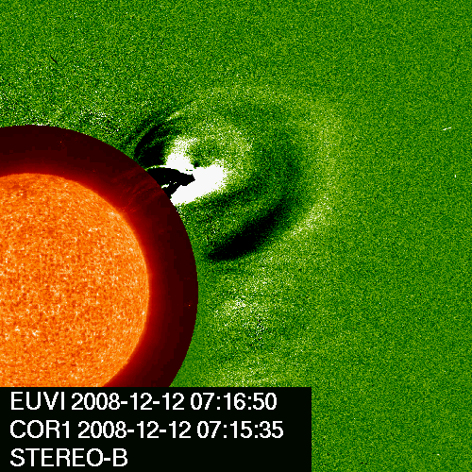
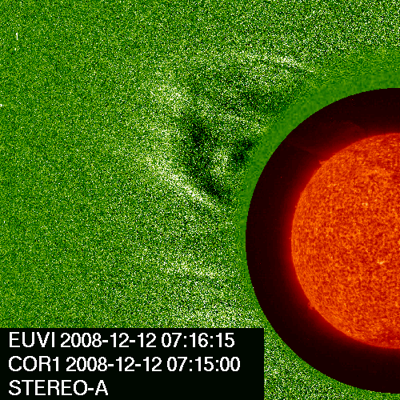
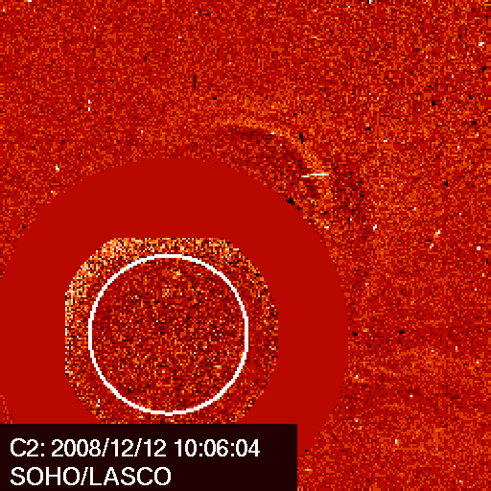
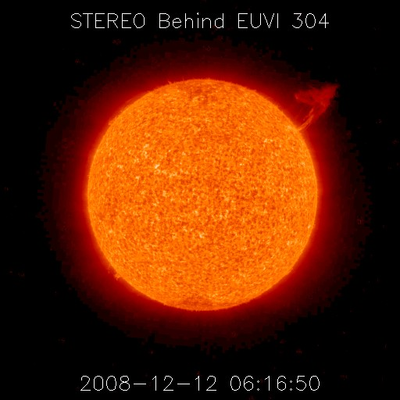
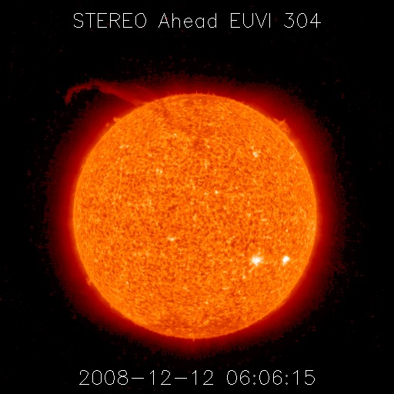
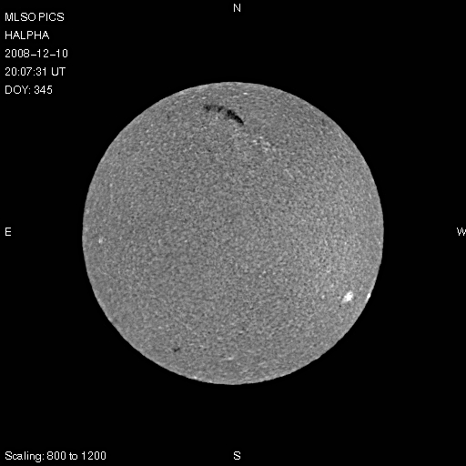
B (W52)
A (E34)
LASCO (W08)
CME: 2008/12/12 04:35; Speed: 252 km/s; A-B sep ang: 86.7
STB: Bright nice FR, nice EUVI 304 EP, N21W52
STA: Wider & fainter, nice EUVI 304 EP, N21E34
LASCO: Faint partial halo, MLSO Hα DSP, ~DC N21W08
Notes:
Here is an example of CME , which has been observed by all three sc, indicates how the CME brightness changes with the limb angle. The CME is the brightest in STB as it is close to limb in STB, the faintest as a partial Halo in Lasco, as it comes towards the sc. the CME in STB is a bright nice FR towards NW, but appears wider and fainter in STA, and the faintest, a partial halo in LASCO. Both EUVI 304 A & B observed a nice EP, and MLSO Ha showed a DSP.

Slide 6
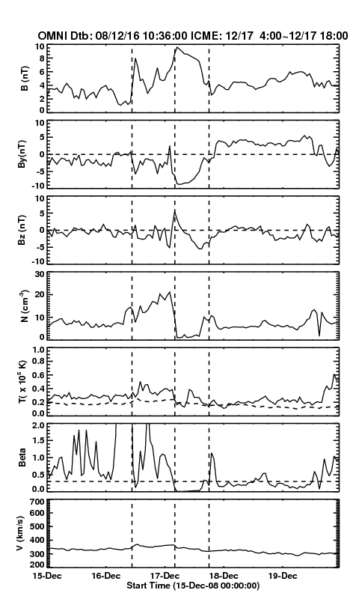
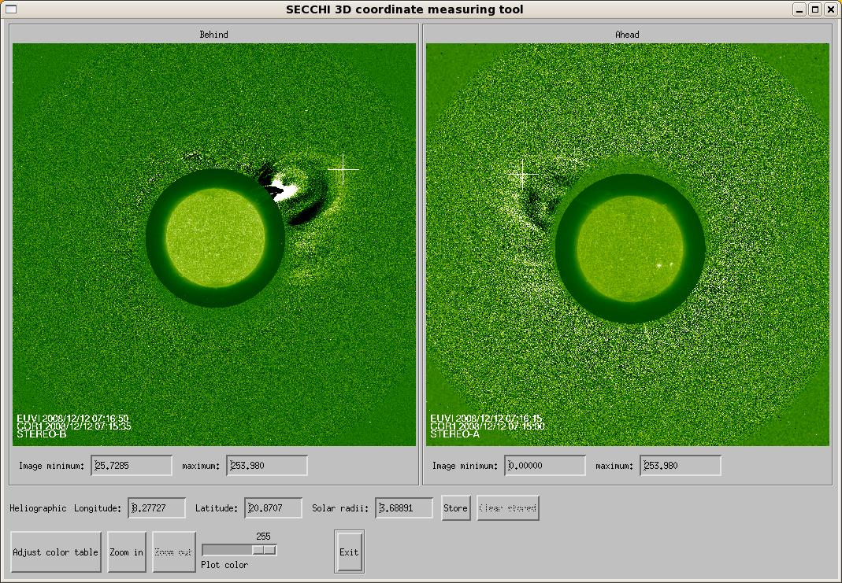
3D triangulation (solarsoft: scc-measure)
CME heliographic loc: N21W08
Dtb: 12/16 10:36 UT
ICME: 12/17 04:00-18:00UT
Bmax = 9. 8 nT, Vmax = 340 km/s
Notes:
Using 3d triangulation (scc_measure), we obtained that the CME loc is N21W08 in heliographic coordinate. And only sc near L-1 observed a nice ICME.

Slide 7
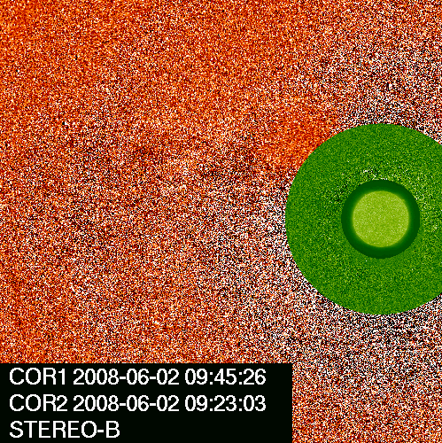
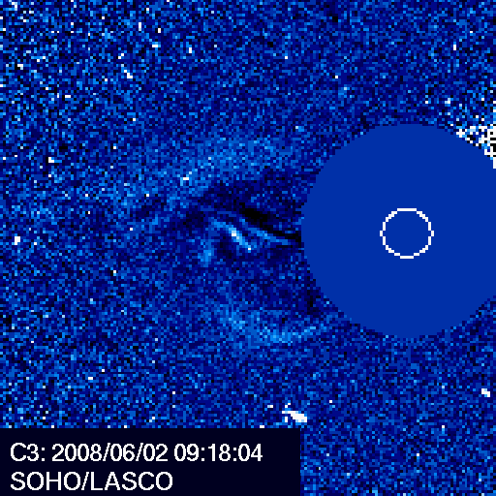
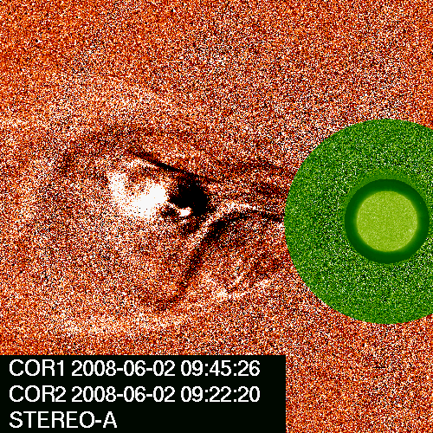
CASE 1: a CME missed by STB
CME: 2008/06/01 not seen in B (E13)
LASCO(E38), A(E67)
Speed: 222 km/s
Nice MC : Bmax = 14. 8 nT, Vmax = 430 km/s
B (E13)
LASCO (E38)
A (E67)
STB/COR Not seen N03E13
LASCO/C3 2008/06/02 04:16 N03E38
STA /COR1 2008/06/01 09:05 N03E67
Notes:
Here is an example of a CME missed by STB, the 2008/06/01 CME, a well-studied CME, only STA and LASCO/C3 detected a relatively wide but faint CME….STB in-situ instruments observed a nice MC.

Slide 8
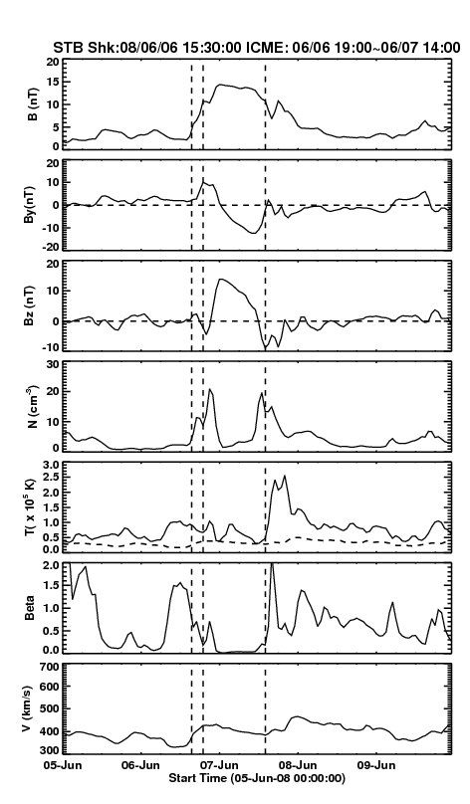
In situ STB (IMPACT & PLASTIC)‏
Shock: 2008/06/06 15:36
ICME: 06/06 19:00 ~ 06/07 14:00
DT: 19 hr
Bmax: 14.8 nT
Vmax: 430 km/s
Comment:
Nice B-rotation, low Beta

Slide 9
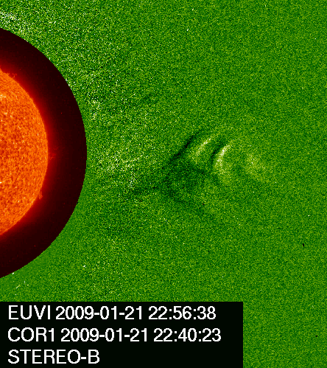
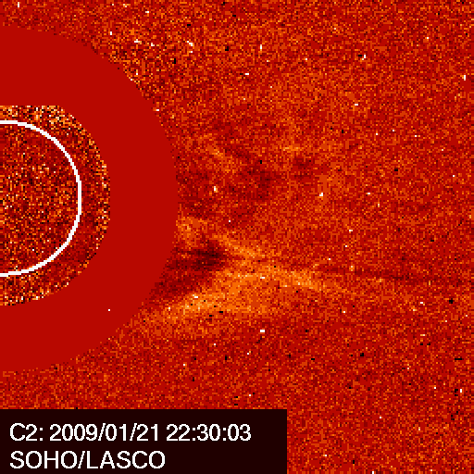
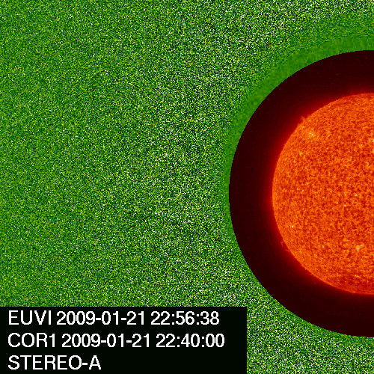
CASE 2: a CME missed by STA
CME: 2009/01/21 not seen in STA (E14)
LASCO(W29), B(W76)
Speed: 227 km/s
B (W76)
LASCO (W29)
A (E14)
STA Not seen S09E14
LASCO/C2 2009/01/21 18:54 S09W29
STB /COR1 2009/01/21 16:45 S09E76
Notes:
Case 2 is a CME missed by STA, only STB observed a faint FR, difficult to see in LASCO and not seen in A.

Slide 10
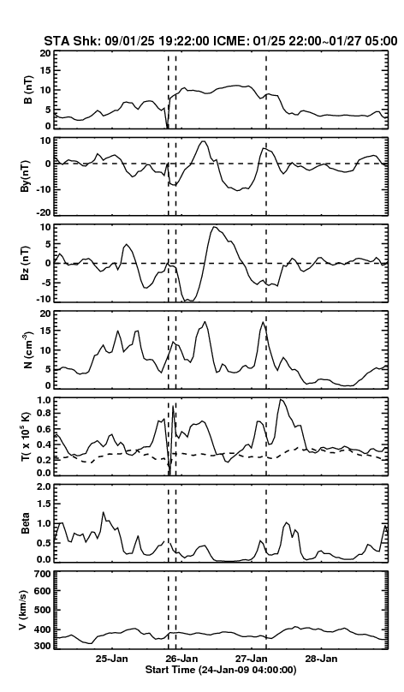
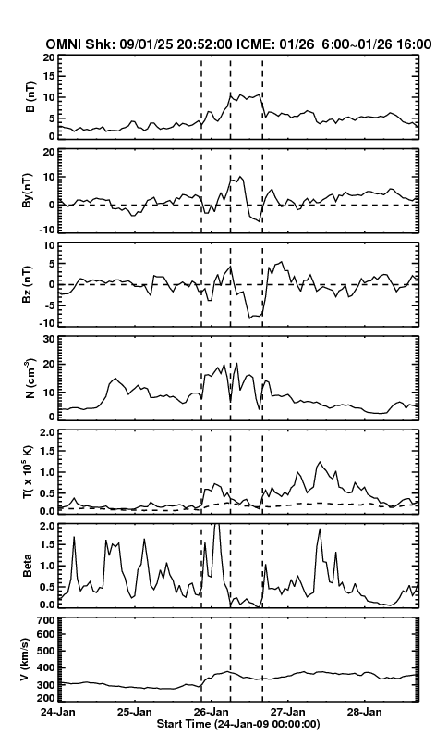
In situ STA (PLASTIC)‏
Shock: 2009/01/25 19:22
ICME: 01/25 22:00 ~ 01/27 05:00
DT: 31 hr Bmax: 11.5 nT
Vmax: 400 km/s
Nice B-rotation, low Beta
In situ STA (PLASTIC)‏
Shock: 2009/01/25 19:22
ICME: 01/25 22:00 ~ 01/27 05:00
DT: 31 hr Bmax: 11.5 nT
Vmax: 400 km/s
Nice B-rotation, low Beta
In situ L1 sc (OMNI)‏
Shock: 2009/01/25 20:52
ICME: 01/26 06:00 ~ 01/26 16:00
DT: 31 hr Bmax: 9.5 nT
Vmax: 400 km/s
Nice B-rotation, low Beta
Notes:
Both STA and L1 sc observed a shock and a ICME with nice B-rot. The shock sheath observed at L1 is longer than that STA, this is due to the CME in STA is more close to dc, and STA may cross the shock through the nose region, while L1 sc pass the shock through flank region.

Slide 11
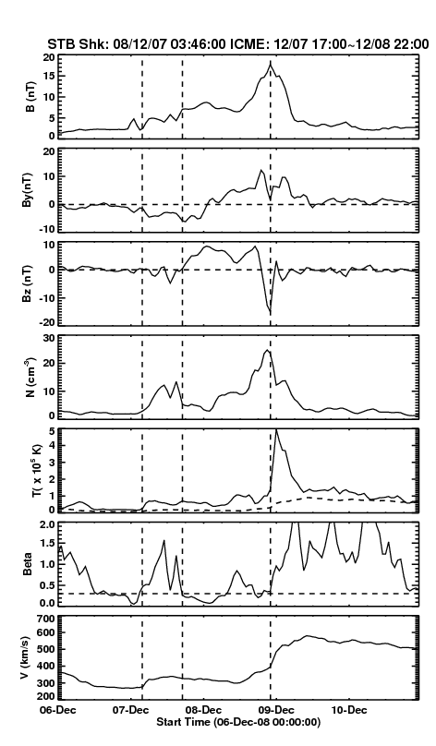
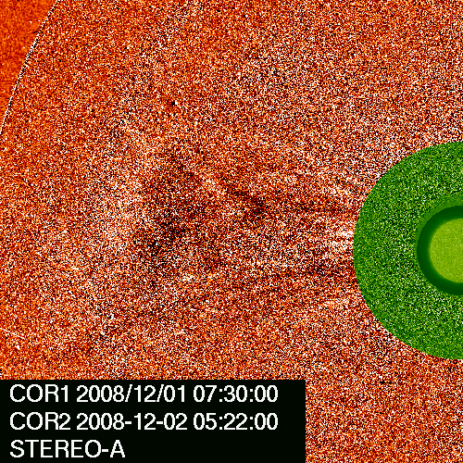
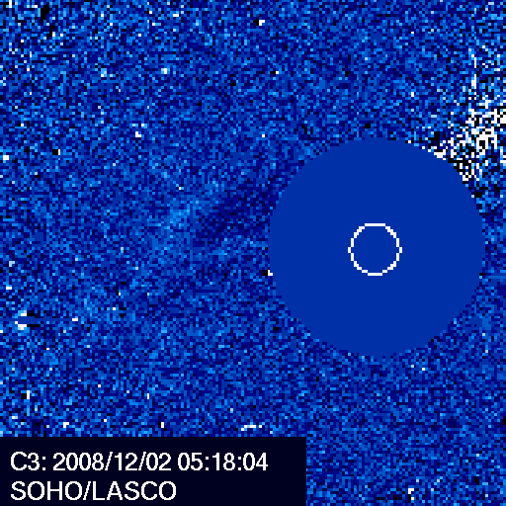
CASE 3: a CME missed by COR1 and COR2-B
CME: 2008/12/01 not seen by B (W02)
LASCO(E41), A(E83) COR2 only
Speed: 227 km/s
A (E83)
LASCO (E41)
In situ STB (PLASTIC)‏
Shock: 2008/12/07 ~03:46
ICME: 12/07 17:00 ~ 12/08 22:00
DT: 29 hr Bmax: 19 nT
Vmax: 350 km/s
Nice B rotation; compressed by a HSS at the rear of ICME
Notes:
Case 3 is a CME missed by both STA and B in COR1….and was only observed by STA in COR2 and LASCO/C3….a shock and ICME, however, was detected by STB, followed by a HSS.

Slide 12
Table 1: ICME disturbance date & time; CME date, time and location; and shock (dtb) travel time
Ref: UCLA ICME list (2007/09 ~ 2009/01):
http://www-ssc.igpp.ucla.edu/forms/stereo/stereo_level_3.html

Slide 13
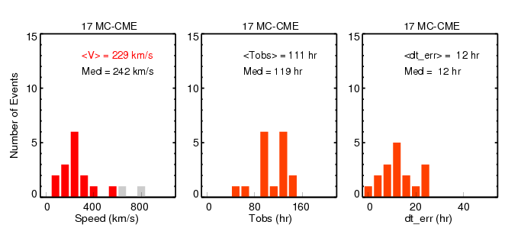
Statistical results
Most ICMEs are associated with faint CMEs missed either by STA or B (15 out
of 17), red bars in left panel, 7 missed by A and 8 missed by B;
2 CMEs (grey bars in left panel) are bright.
12 of 17 ICMEs are preceded by shocks
Average speed of 15 faint CMEs: 229 km/s (left )
Average CME-driven shock or disturbance travel time: 111 hrs (middle)
The predicted travel time error by ESA: 12 hr (right)
Ref: ESA--Empirical Shock Arrival model(Gopalswamy et al., 2005)

Slide 14
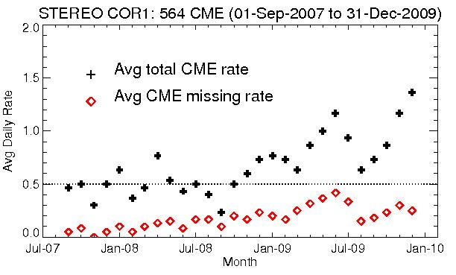
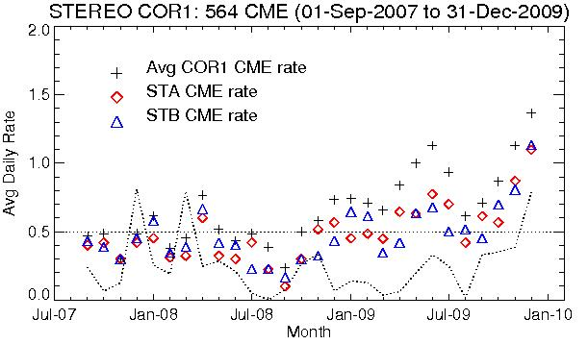
Statistics:
CME missing rate & CME total rate
CME total rate vs. Missing rate
SOHO LASCO CME Rate in 1996-1997 was ~0.5 CMEs/day
The missing rate reaches
maximum of ~ 0.4 CMEs/day
when A-B separation angle is ~100 degrees on Jun-2009.
CME total rate around Jun-09 is
overrated due to A & B has larger
possibilities seeing different
events
CME separation rate of A & B
rose starting on Oct-2009,
consistent with SSN curve (dash
line in bottom panel.
CME total rate vs. STA (B) rate
Notes:
monthly averaged..total CME rate is the sum of CMEs observed by either A or B.
If a CME is missed by either A or B, we count it as a missing rate.

Slide 15
Conclusions
Faint CMEs are important sources for the shocks
and ICMEs detected at 1 AU during solar minimum.
CME monthly averaged daily rate has started to
pick up since Oct-2009.

Slide 16
CME missing rate
Table 2: CME (STA/B, LASCO) first appearance time and location
ref. http://cor1.gsfc.nasa.gov/catalog/
http://cdaw.gsfc.nasa.gov/CME_list/index.html

