Slide 1
Plasma Simulations in Support of the Stereo Mission
Tamas Gombosi, Ofer Cohen, Bart van der Holst, Ward Manchester, Igor Sokolov, Gabor Toth
University of Michigan

Slide 2
Outline
SWMF
Synoptic solar wind
April 20, 2007 pre-event solar wind
Coronal tomography
CME breakout simulation

Slide 3
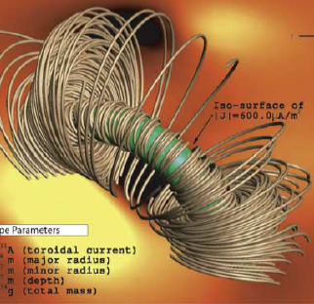
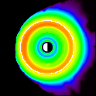
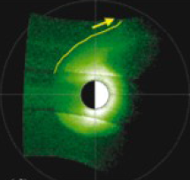
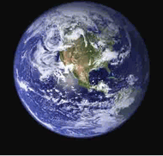
Space Weather Modeling Framework (SWMF)
Flare/CME
Observations
Upstream
Monitors
SWMF Control & Infrastructure
Eruption
Generator
Radiation
Belts
Energetic
Particles
Polar Wind
Plasmasphere
3D Inner
Heliosphere
Couplers
F10.7 Flux
Gravity
Waves
Global
Magnetosphere
Thermosphere
& Ionosphere
3D Corona
Inner
Magnetosphere
Ionospheric
Electrodynamics
Lower
Atmosphere
Synoptic
Magnetograms
Radars
Magnetometers
In-situ

Slide 4
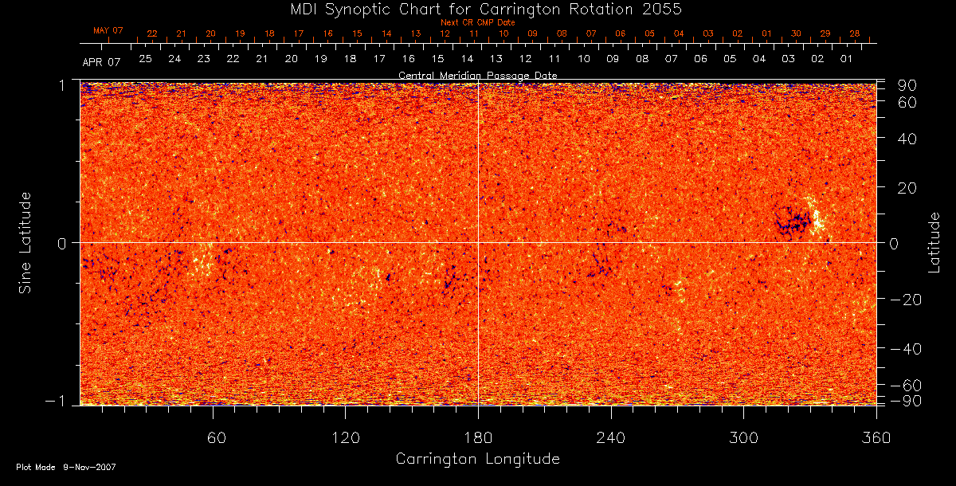
MDI Magnetogram for April 2007

Slide 5
MHD Synoptic Corona for April 2007 (Ofer Cohen & Chip Manchester)

Slide 6
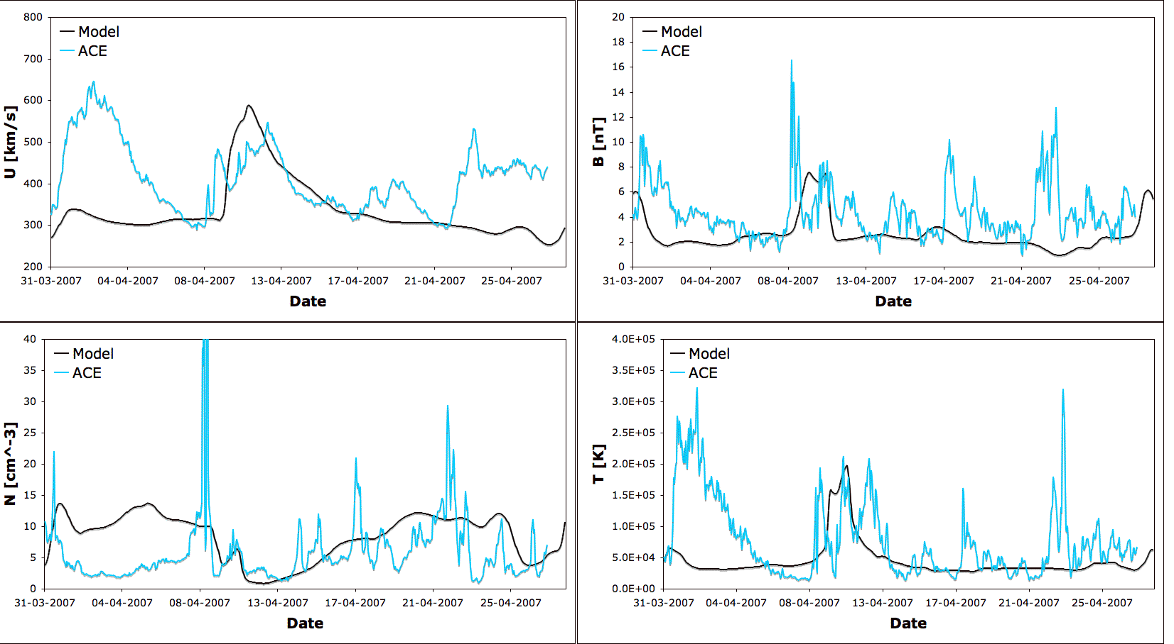
Comparison with ACE, April 2007 (Ofer Cohen)

Slide 7
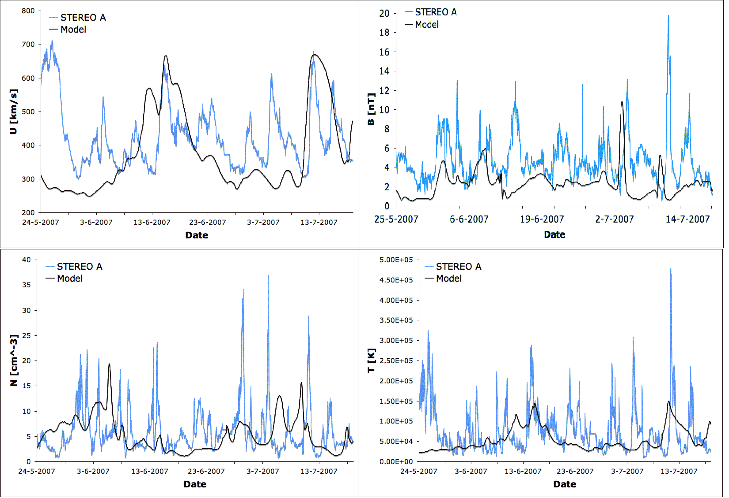
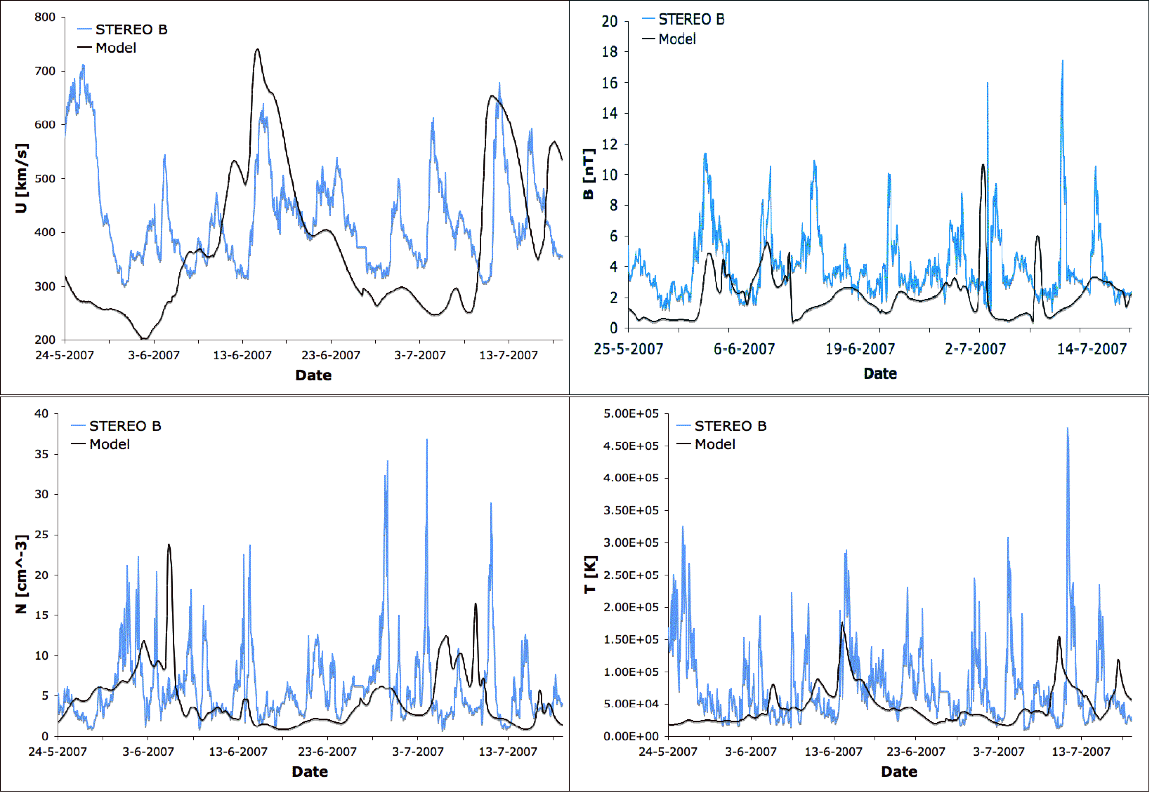
Comparison with ACE at 1 AU (Ofer Cohen)
May 26 – July 7, 2007

Slide 8
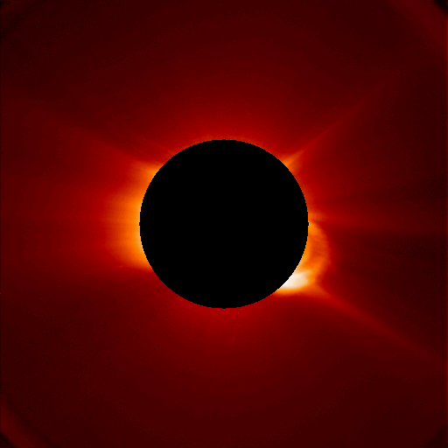
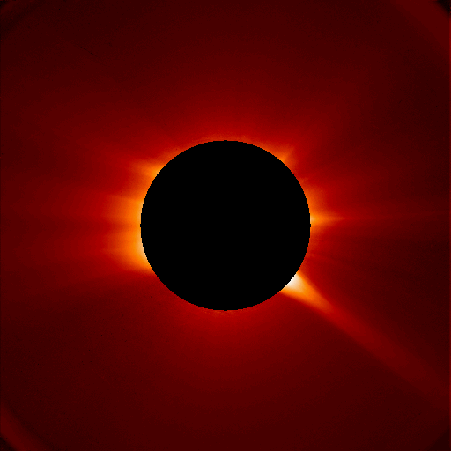
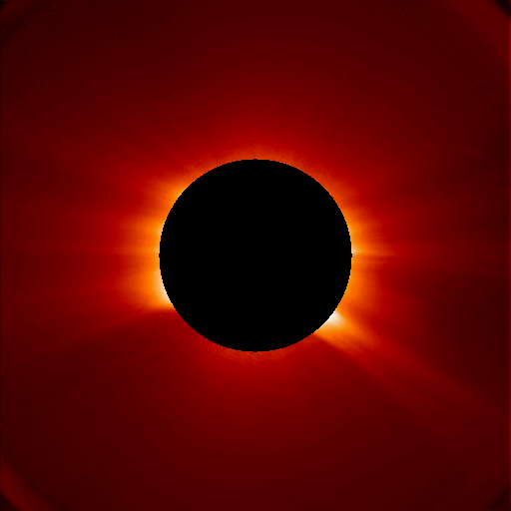
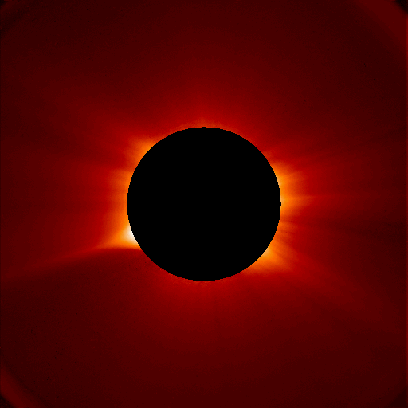
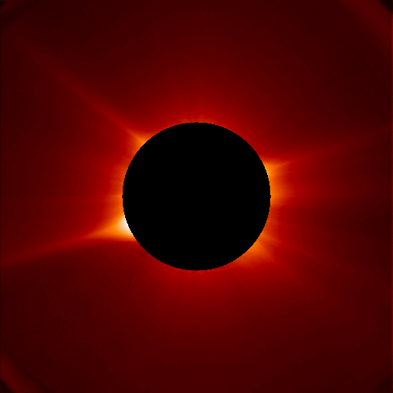
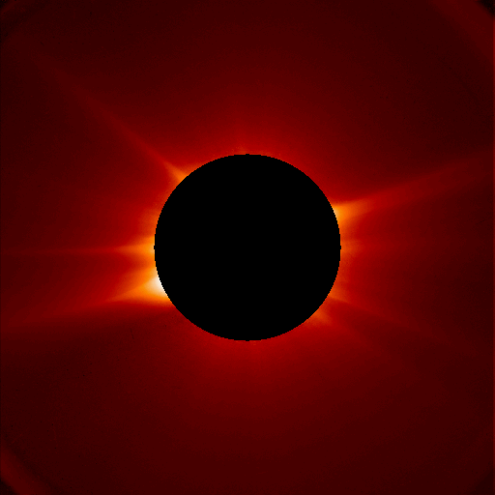
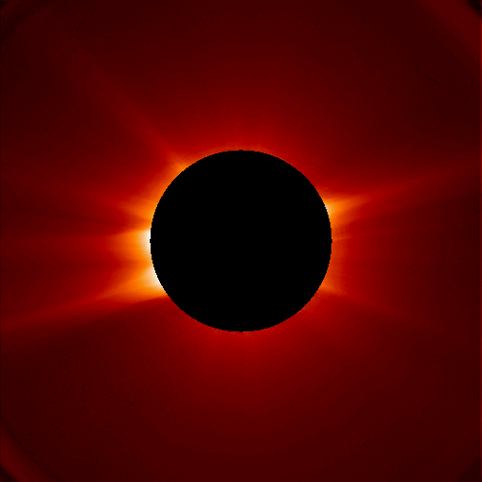
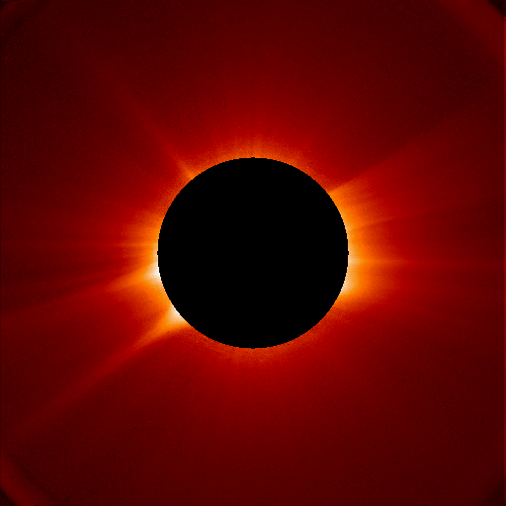
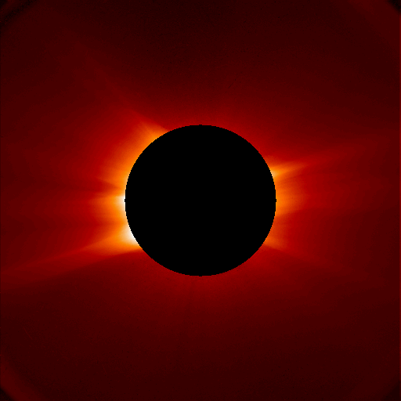
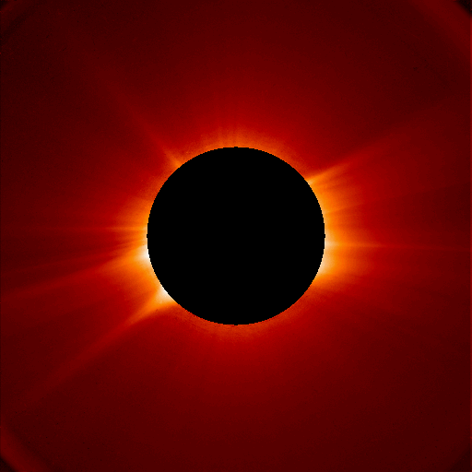
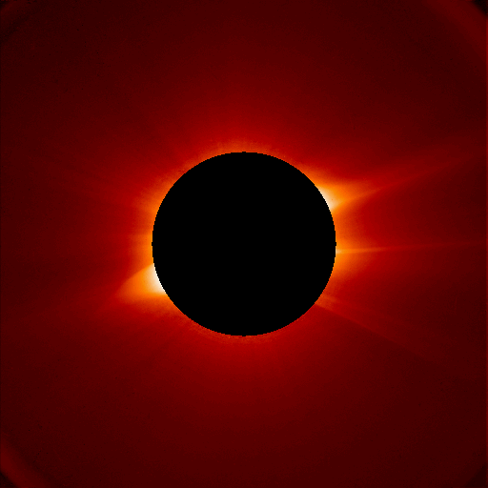
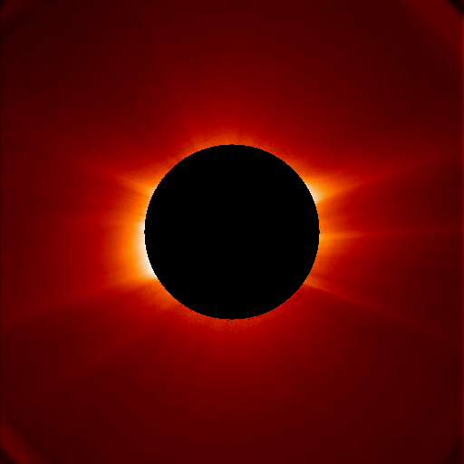
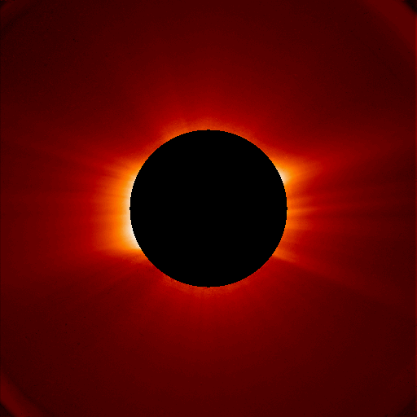
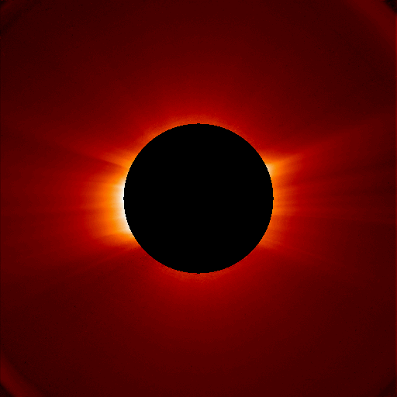
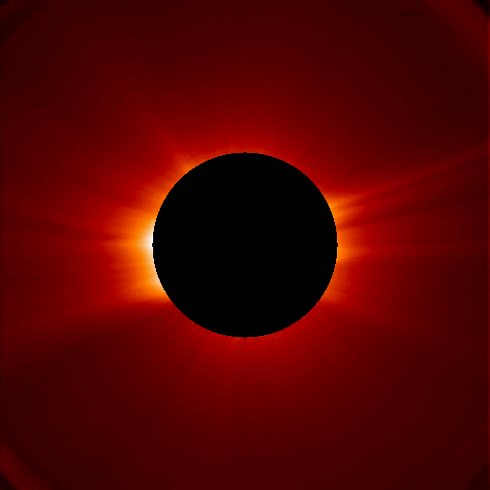
SOHO C2 2005 05 15 21:05
SOHO C2 2005 05 17 21:05
SOHO C2 2005 05 19 21:05
SOHO C2 2005 05 14 21:03
SOHO C2 2005 05 16 21:00
SOHO C2 2005 05 18 21:00
Rich Frazin brought 3D tomography capability to CSEM. His line-of-sight image inversion technology can reproduce the global coronal electron density distribution using coronagraph images. It takes half a solar rotation of imaging data to create a full 3D electron density distribution between 1 R_{s} and ~6 R_{s}.
SOHO C2 2005 05 20 21:00
SOHO C2 2005 05 27 23:44
SOHO C2 2005 05 21 0306
SOHO C2 2005 05 27 21:00
SOHO C2 2005 05 26 21:05
SOHO C2 2005 05 24 21:05
SOHO C2 2005 05 22 21:05
SOHO C2 2005 05 25 21:00
SOHO C2 2005 05 23 21:00
SOHO C2 2005 05 21 21:05

Slide 9
Tomography and WSA-MHD Field Lines (Rich Frazin & Chip Manchester)

Slide 10
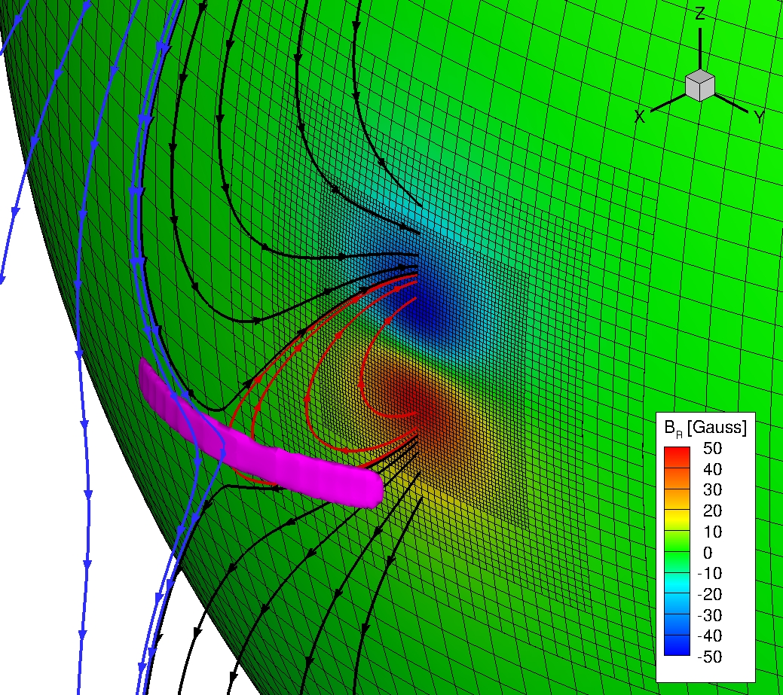
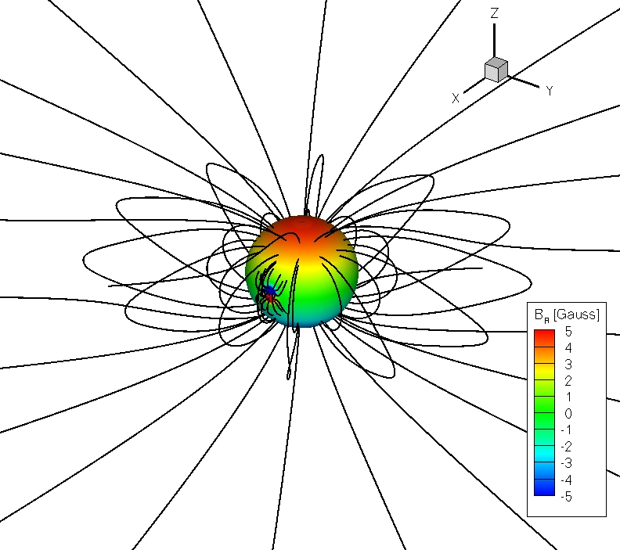
Breakout Simulation Geometry (Bart van der Holst)

Slide 11
2D Breakout Simulation

Slide 12
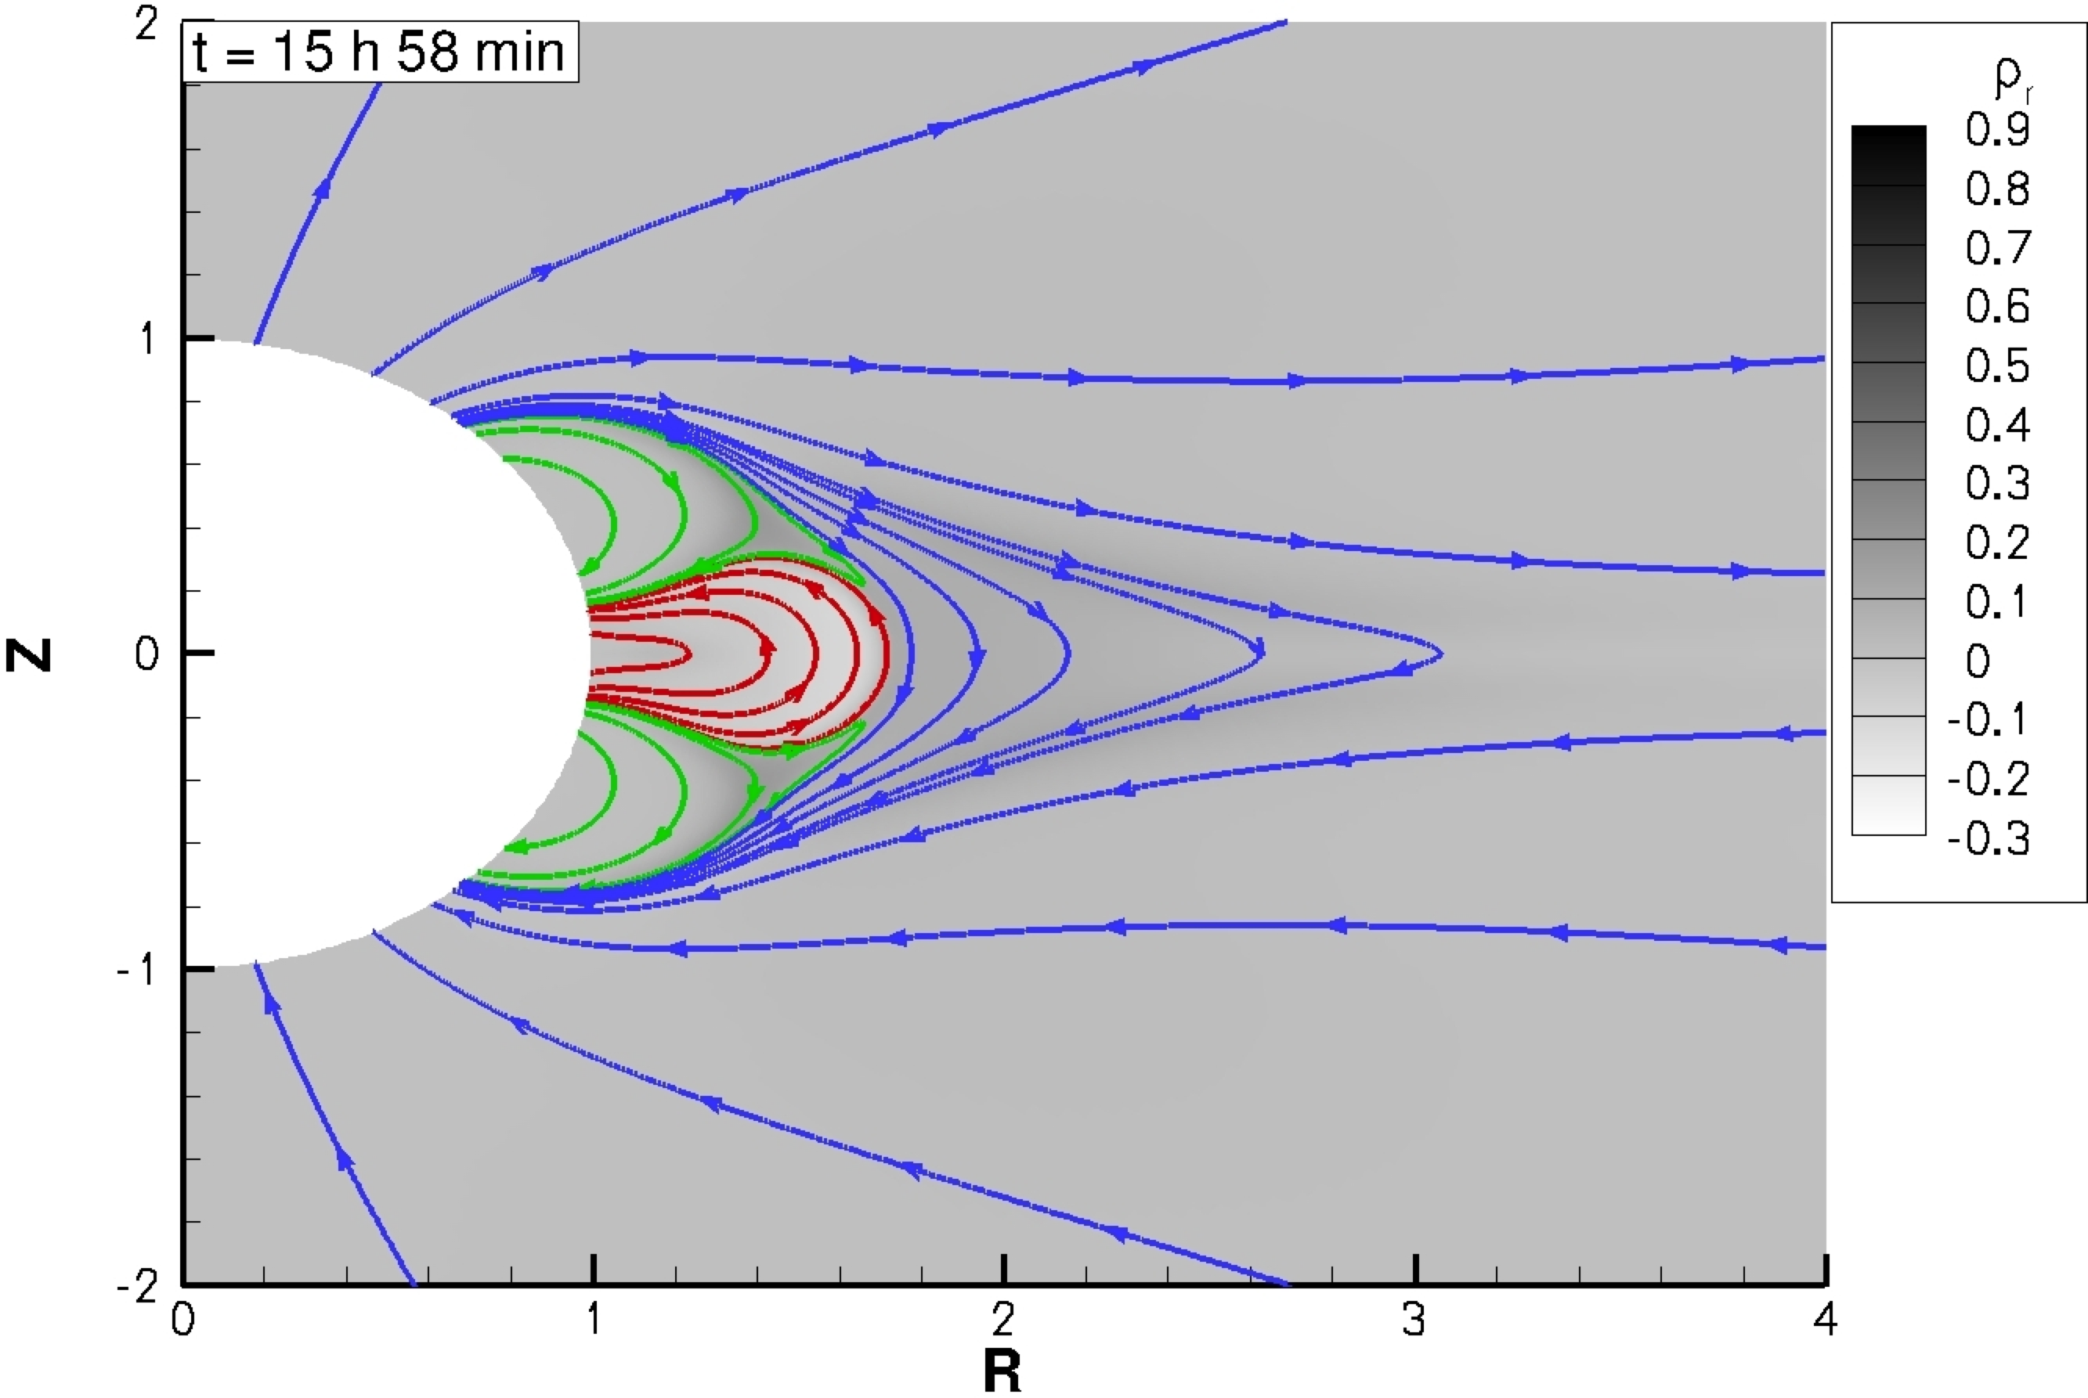
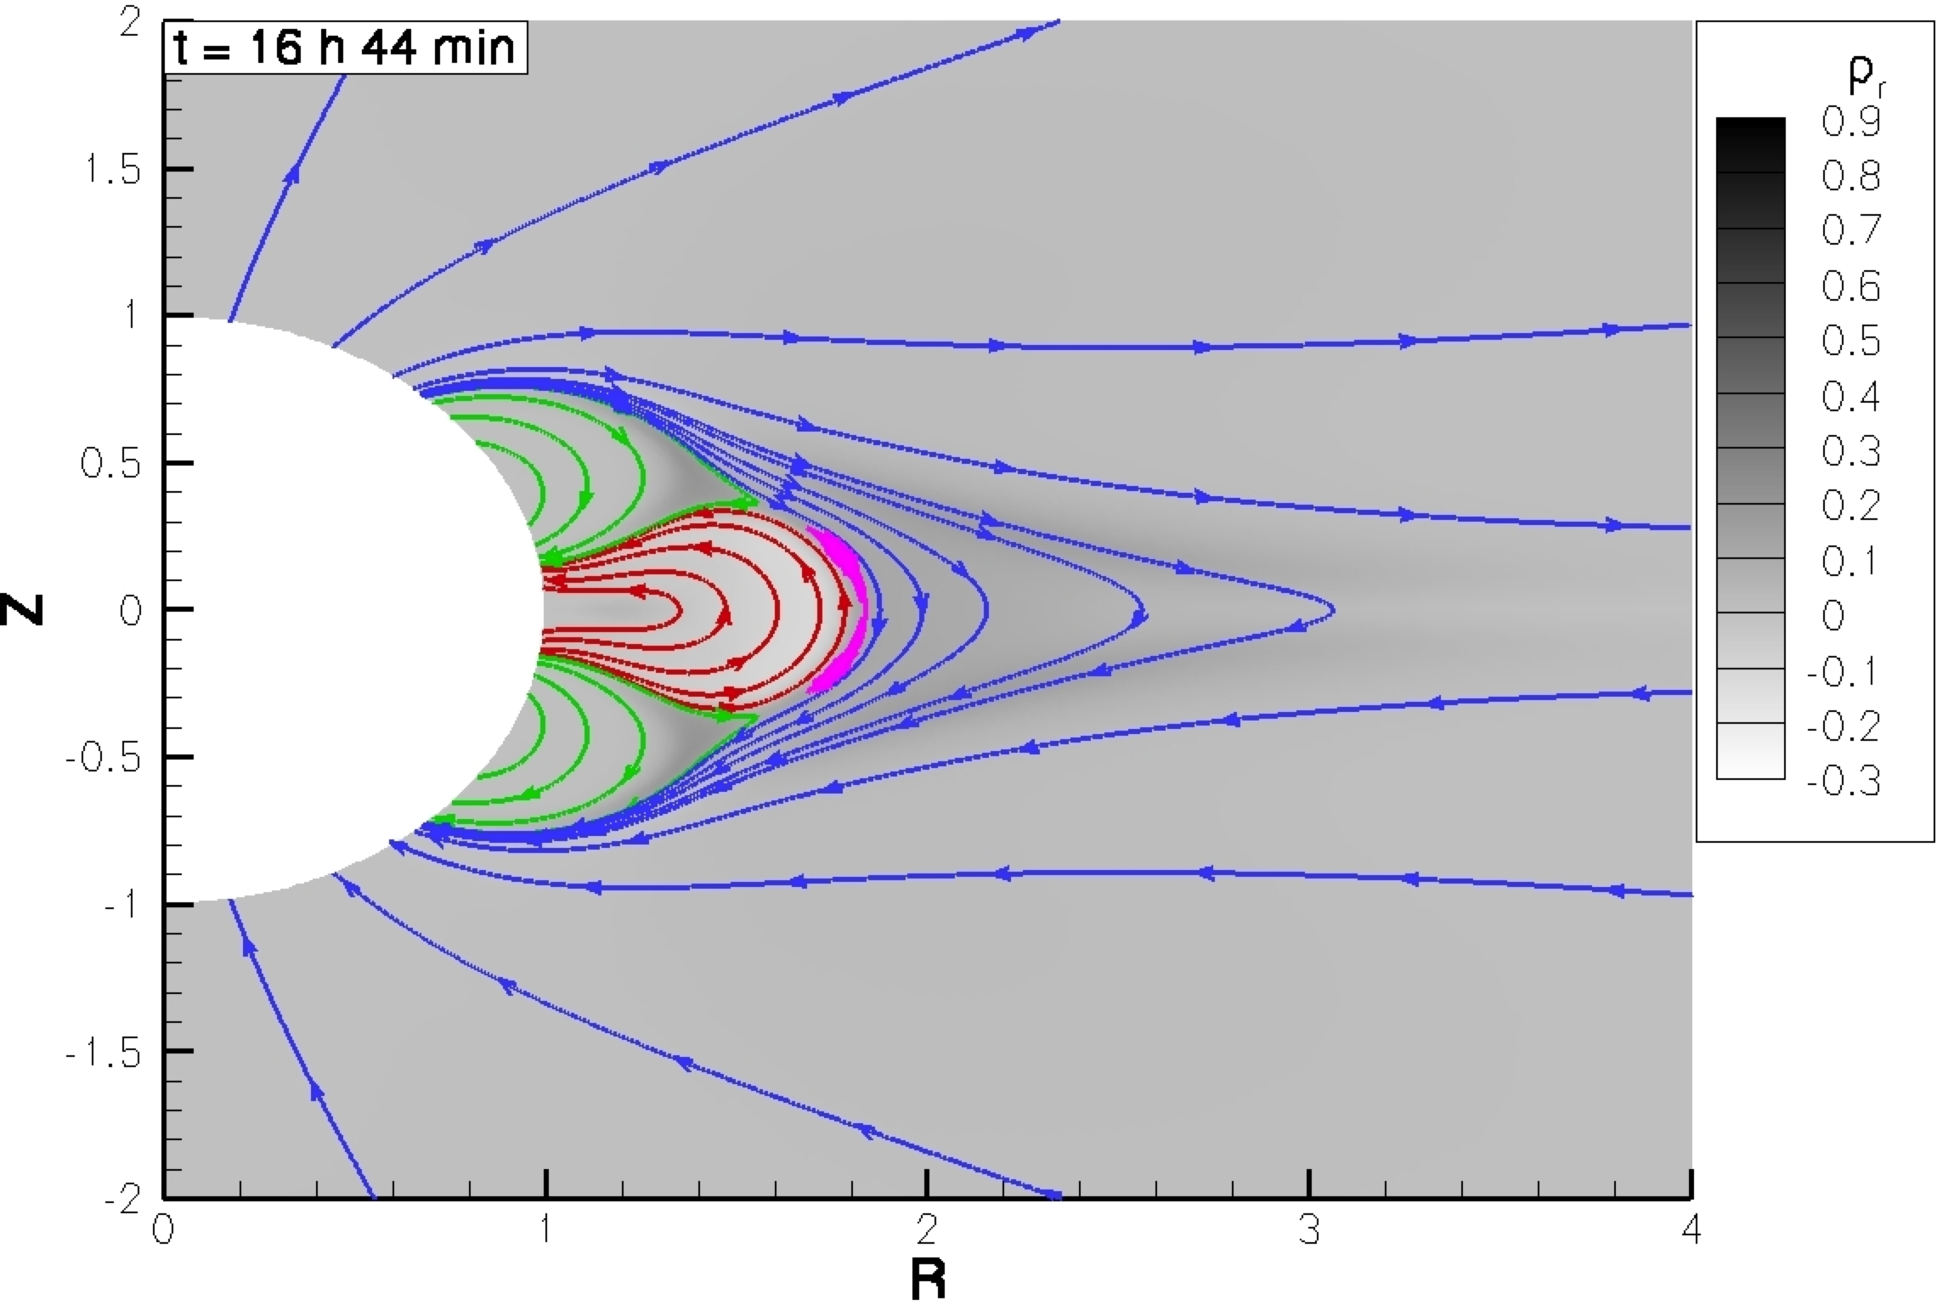
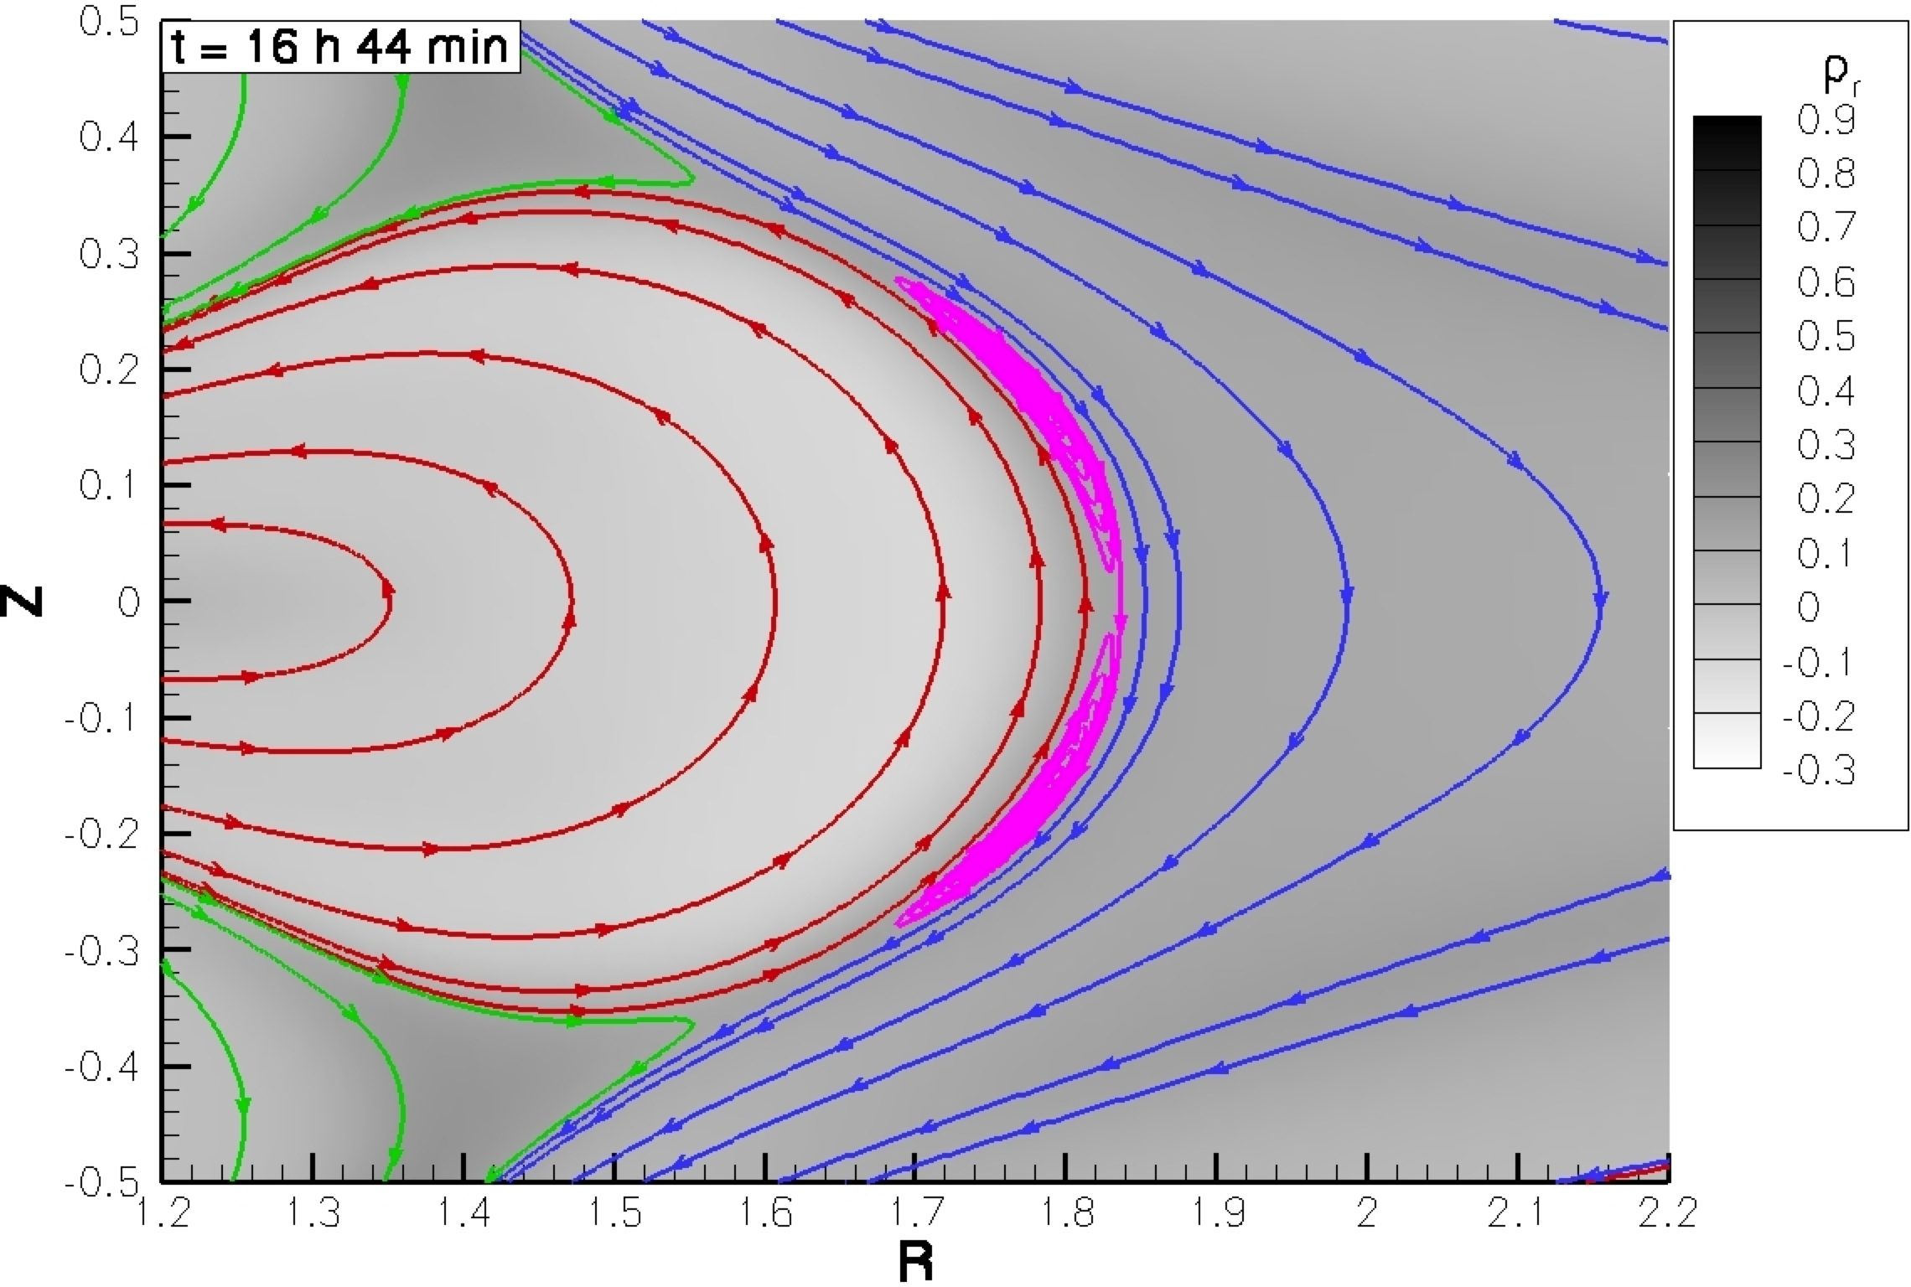
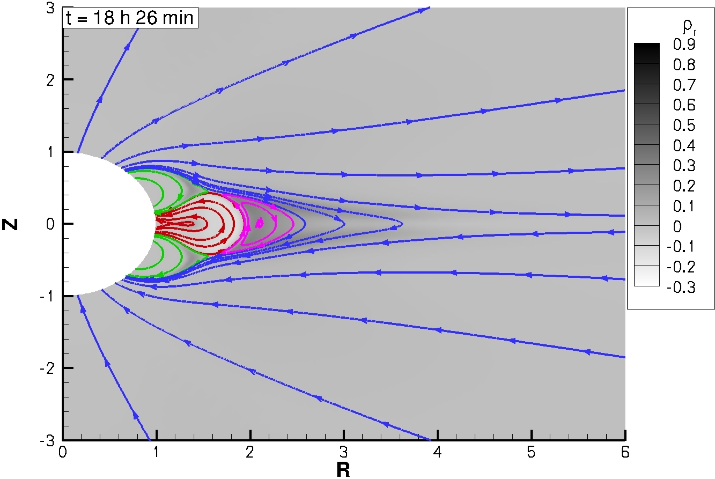
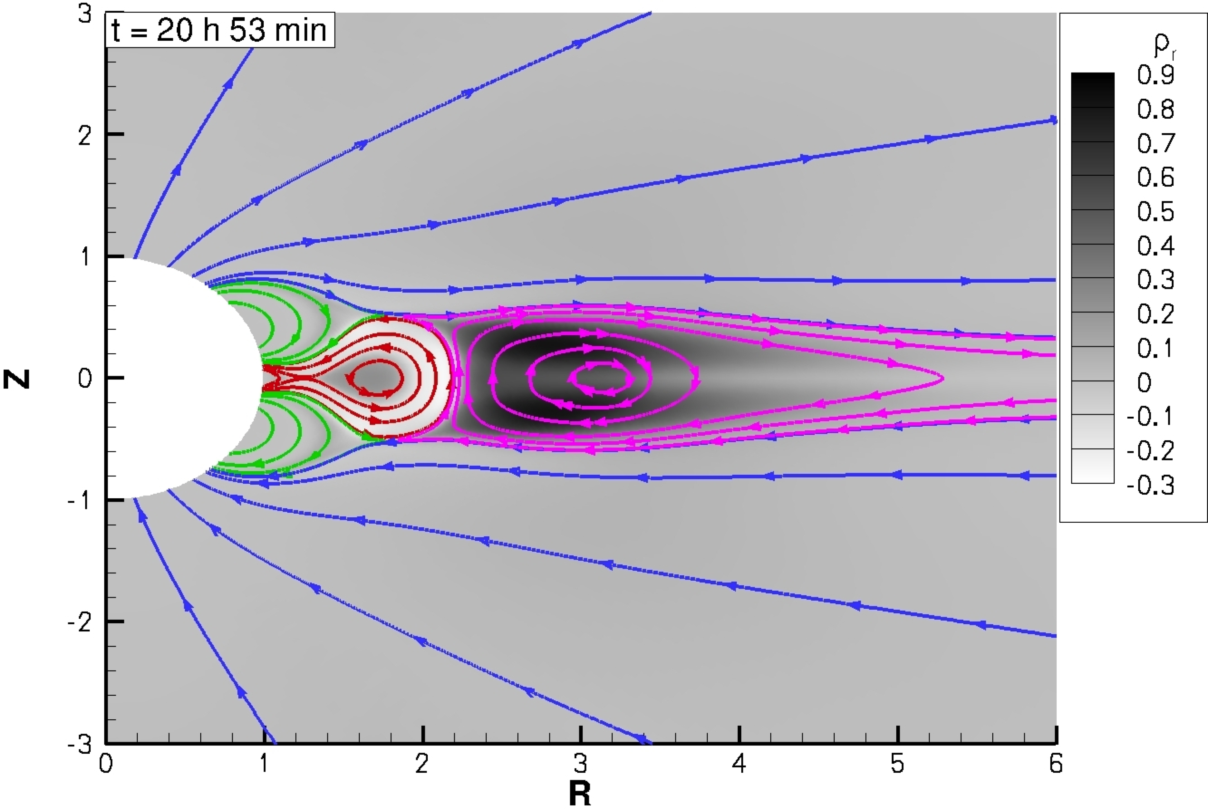
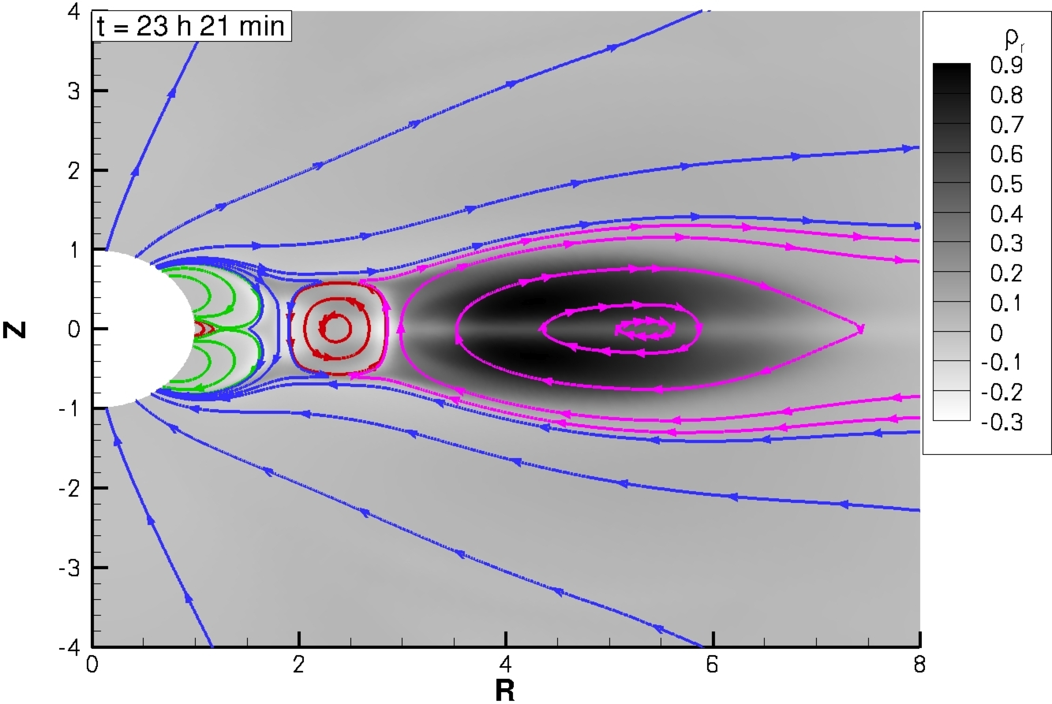
CME Formation

Slide 13
Summary
Magnetogram based synoptic MHD simulation is working
Results are as good as the magnetogram input
Detailed validation is needed
April 20, 2007 event is investigated
Interaction with comet Encke
Coronal tomography looks very promising
Breakout CME initiation has been implemented
2S results are promising
3D simulation is under way

