Slide 1
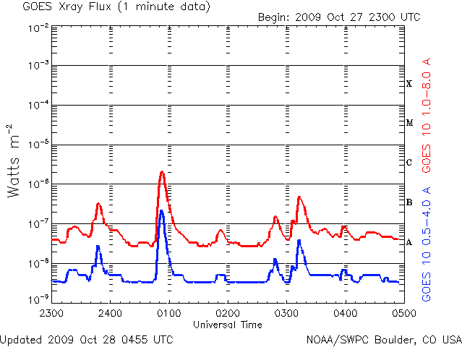
Flares in 2007-2009 and their associations with CMEs
N.V. Nitta, J.P.Wuelser, M. J. Aschwanden, J. R. Lemen (LMSAL), D. M. Zarro (Adnet, Inc.)

Slide 2
Flares in solar minimum 23-24
Overview of EUVI observations of flares by Aschwanden et al., 2009 Solar Phys. Topical Issue
This talk (based on http://www.lmsal.com/nitta/movies/flares_euvi/index.html)
Study CME associations of flares using EUVI and COR1 data extended to COR2 and LASCO fields of view
Study large-scale dimming in EUVI data in association with CMEs

Slide 3
CMEs and flares
Eruptive flares and filament eruptions can be understood in terms of a common mechanism to launch CMEs. But CMEs may be occasionally observed with essentially confined flares and their relation is not well understood.
90% 50% 20%
The CME association rate increases with larger flares, but the possibility of different origins of CMEs may still exist.
Yashiro et al. 2005

Slide 4
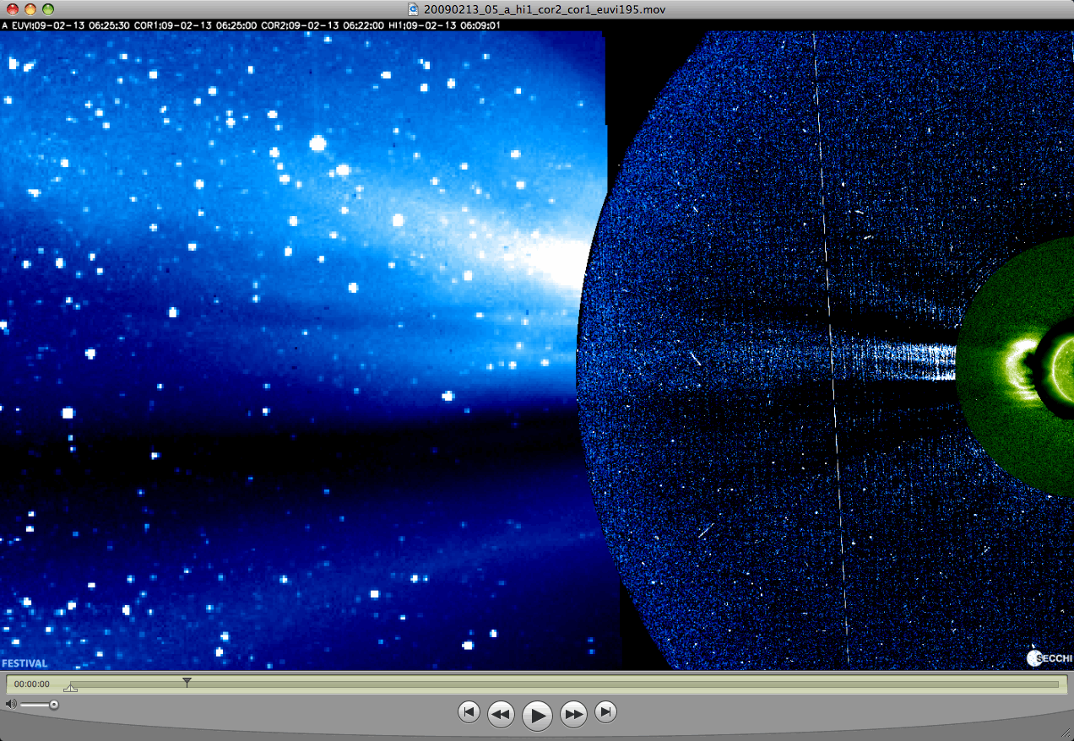
Composite movies of EUVI and COR1 images
Use FESTIVAL (http://www.ias.u-psud.fr/stereo/festival/) as incorporated in SolarSoft. FESTIVAL can also display other data.

Slide 5
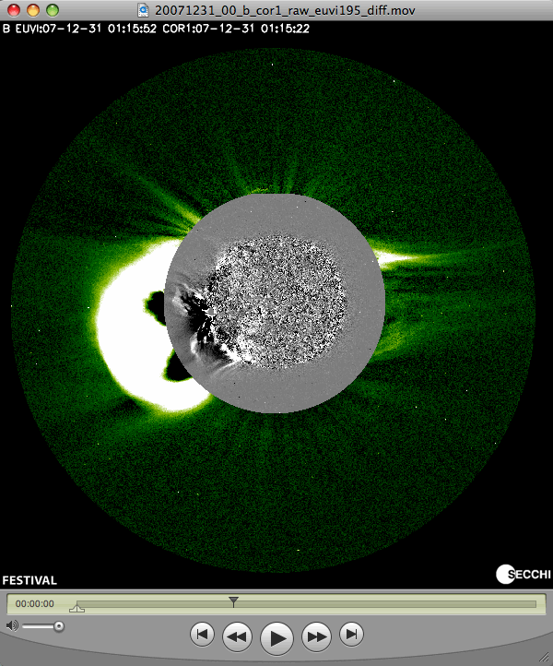
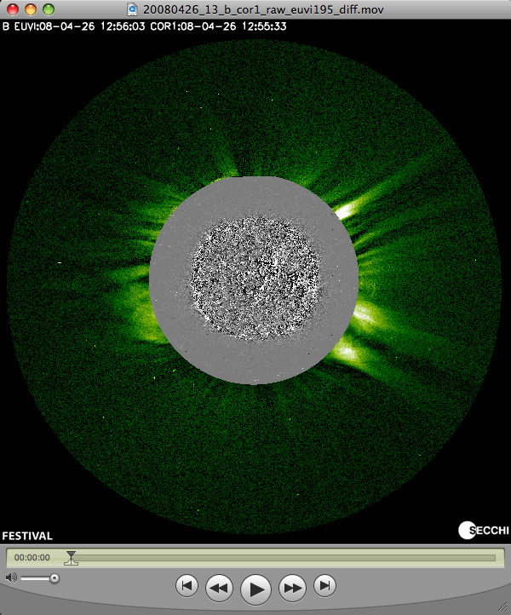
Composite movies of EUVI and COR1 images
Examples

Slide 6
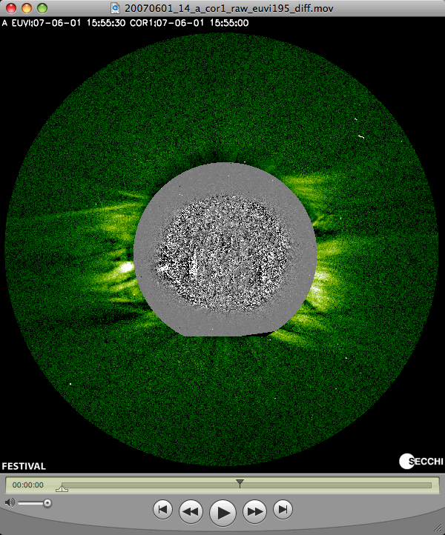
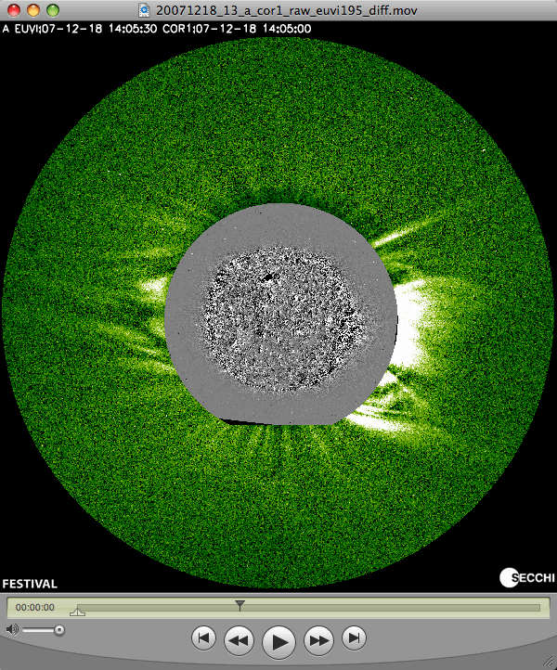
Composite movies of EUVI and COR1 images
Examples

Slide 7
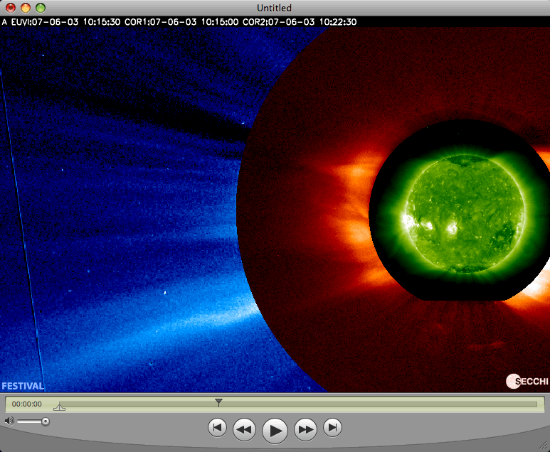
Composite movies of EUVI, COR1 and COR2 images
Example

Slide 8
Flares March 2007 – July 2009
No X-class flares
11 M-class flares
64 C-class flares
AR CM passage | M | C
953 2007/05/01 |  | 3
956 2007/05/19 |  | 2
960 2007/06/07 | 10 | 14
962 2007/07/03 |  | 2
963 2007/07/15 |  | 15
966 2007/08/09 |  | 2
969 2007/08/27 |  | 1
978 2007/12/11 |  | 9
980 2008/01/08 |  | 5
987 2008/03/27 |  | 1
989 2008/04/01 | 1
1007 2008/11/01 |  | 2
1024 2009/07/05 |  | 2
No # 2008/12/04 |  | 1
2 CME associated
7 CME associated
These flares are poorly associated with CMEs. This is largely because most of them occurred in a small number of active regions that were CME poor.
We also study flares or brightenings below the C-level if they occur in isolation from others or if they show signatures that are attributed to CMEs.

Slide 9
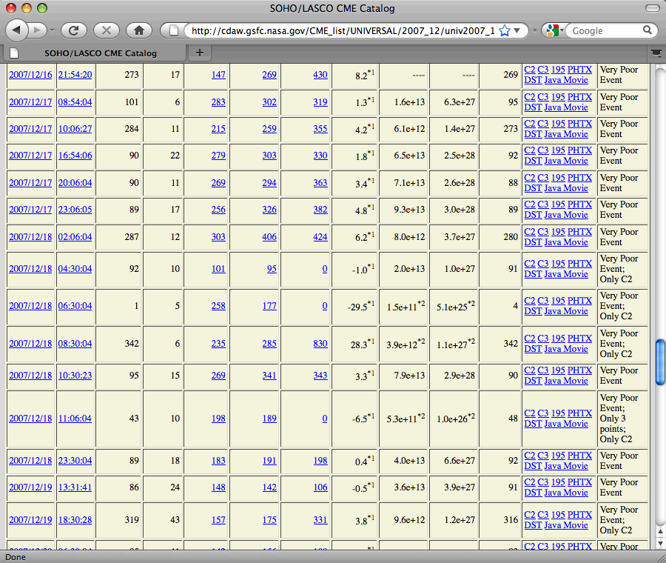
It is possible that experts can see more CMEs, but how can we confirm them?

Slide 10
CME-rich and CME-poor active regions
New cycle or old cycle polarity
Age – perhaps does not matter, most of ARs dying within first rotation
Field strength
Area
Non potentiality around the polarity separation line
Rapid changes (e.g., flux emergence)
Location with respect to large scale field

Slide 11
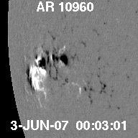
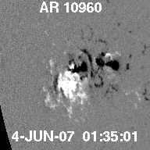
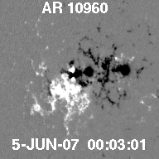
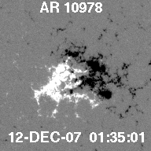
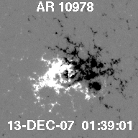
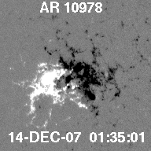
CME-poor active regions
Relatively large sunspot areas (>200 millionth solar disk), old cycle polarity, conforming to Joy’s law, large non-potentiality indices (cf. Schrijver 2007)

Slide 12
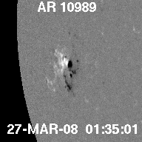
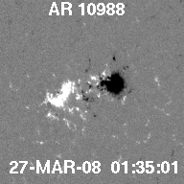
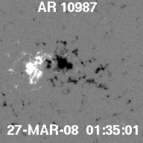
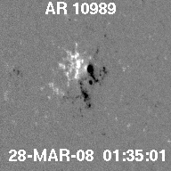
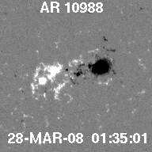
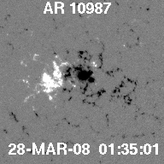
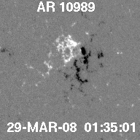
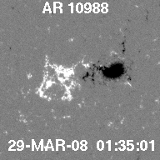
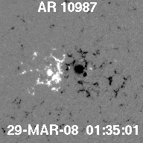
Triple active regions
Time
Despite the smaller sunspot area (~50 millionth) and weaker gradient around the polarity separation line, AR 1098o was responsible for the big CME on 25 March 2008.

Slide 13
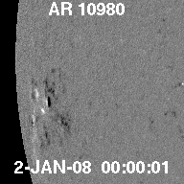
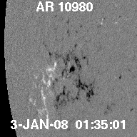
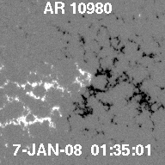
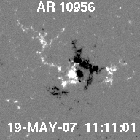
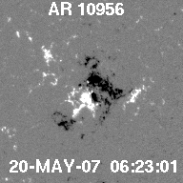
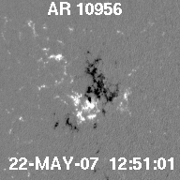
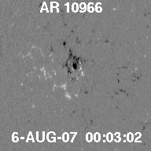
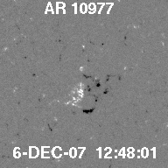
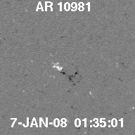
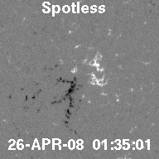
Active regions that were not too CME-poor
CME-poor AR 10978 decayed to an AR with spot area of ~10 millionth. Source region for big CMEs on 31-Dec-2007 and 2-Jan-2008.
In violation of the Joy’s law. High gradient around the polarity separation line. CME activity continued even after the region decayed.

Slide 14
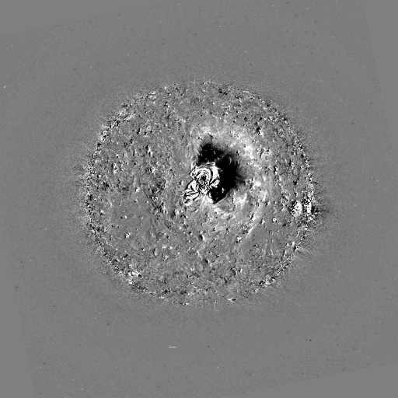
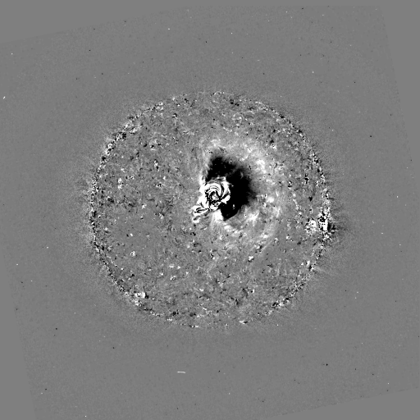
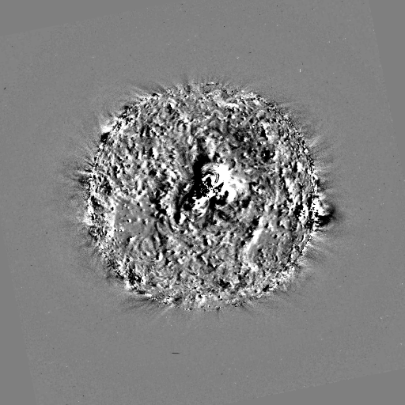
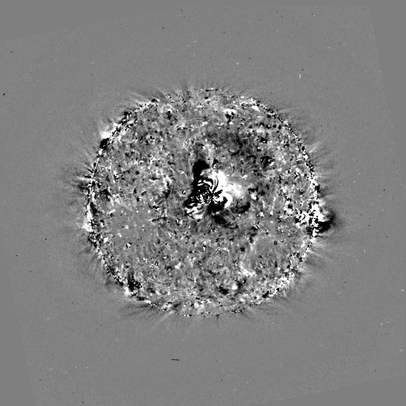
Survey of EUVI data with movies
To detect CME-related phenomena (eruption, dimming and wave), we need to study both intensity and difference images.
Waves are usually seen in running difference images, but persistent dimming also needs base difference images.
To make a difference movie, the pairs have to be corrected for solar rotation.
Use SolarSoft mapping routines. Correction is only approximate, producing more artificial patterns for longer time difference.
Here, the off-limb pixels are kept unchanged, and the later image is de-rotated to the time of the earlier image. This results in disk pixels close to the west limb not being filled.
uncorrected
corrected
uncorrected
corrected
dt=30 min
dt=3 hr 20 min

Slide 15
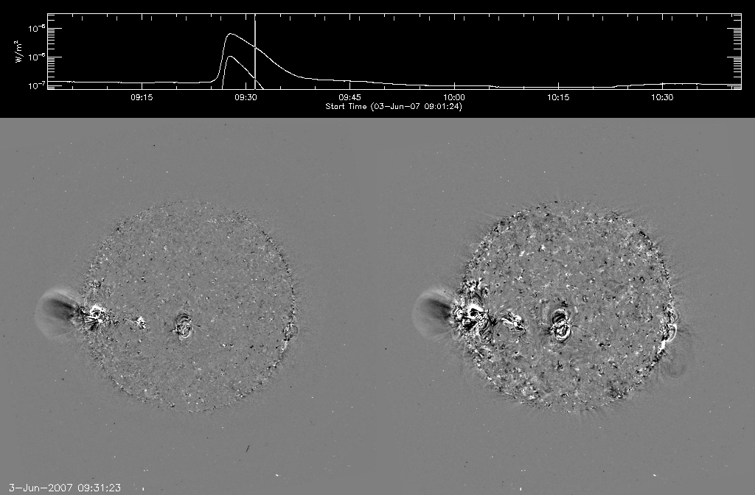
Examples of difference movies
CME

Slide 16
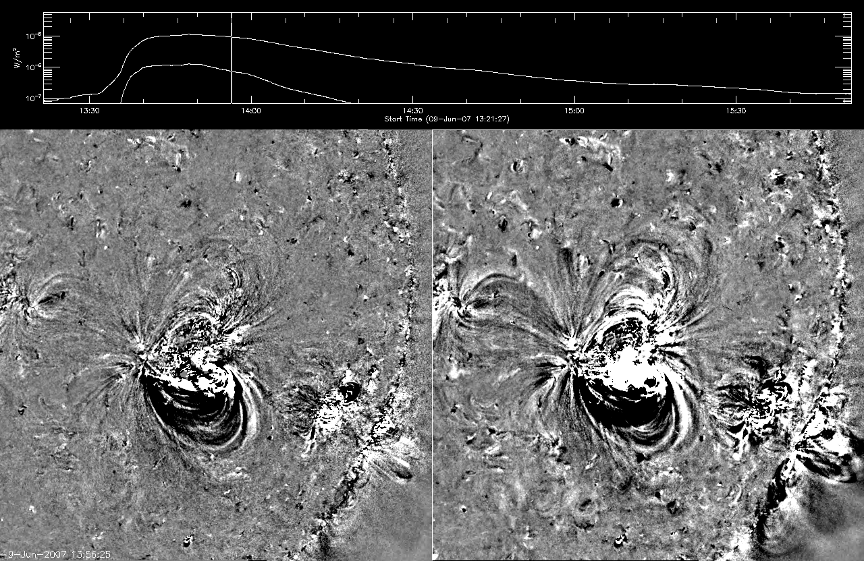
Examples of difference movies
Confined ejection or loop expansion

Slide 17
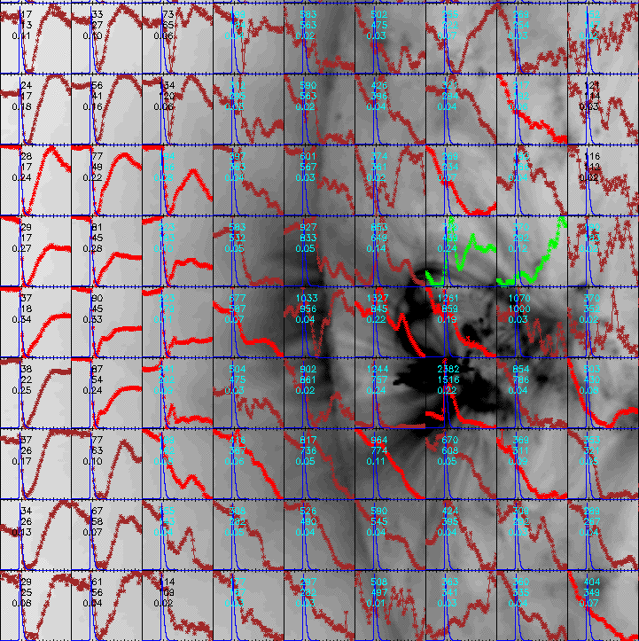
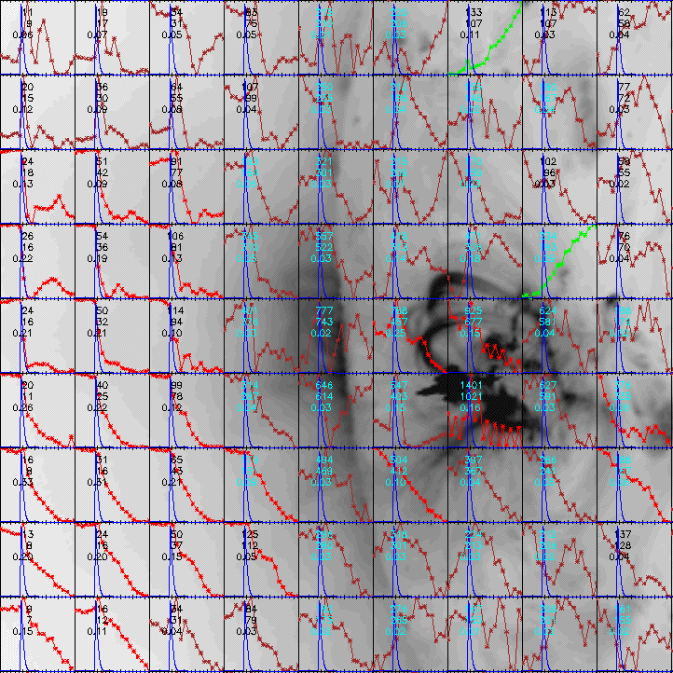
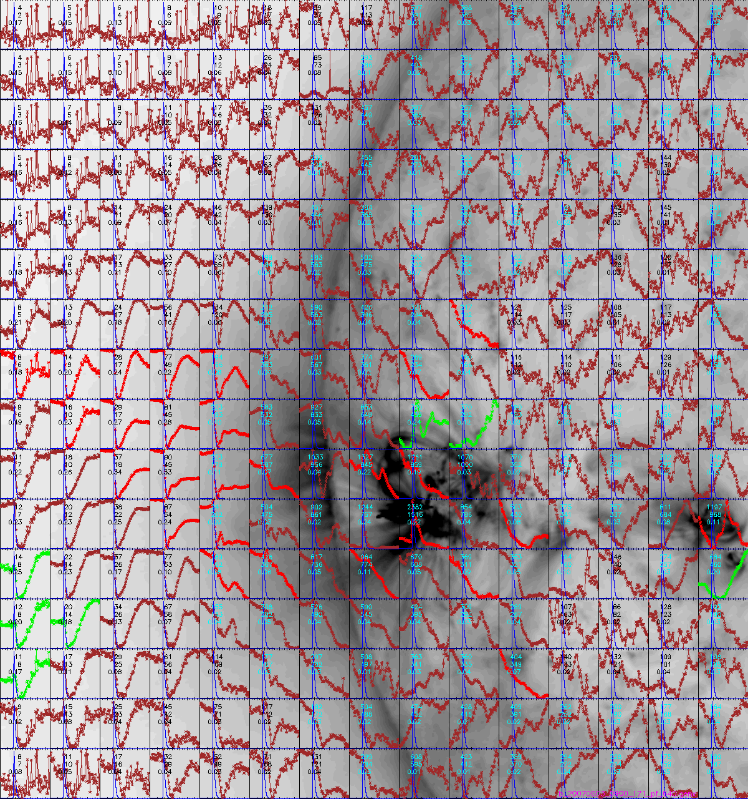
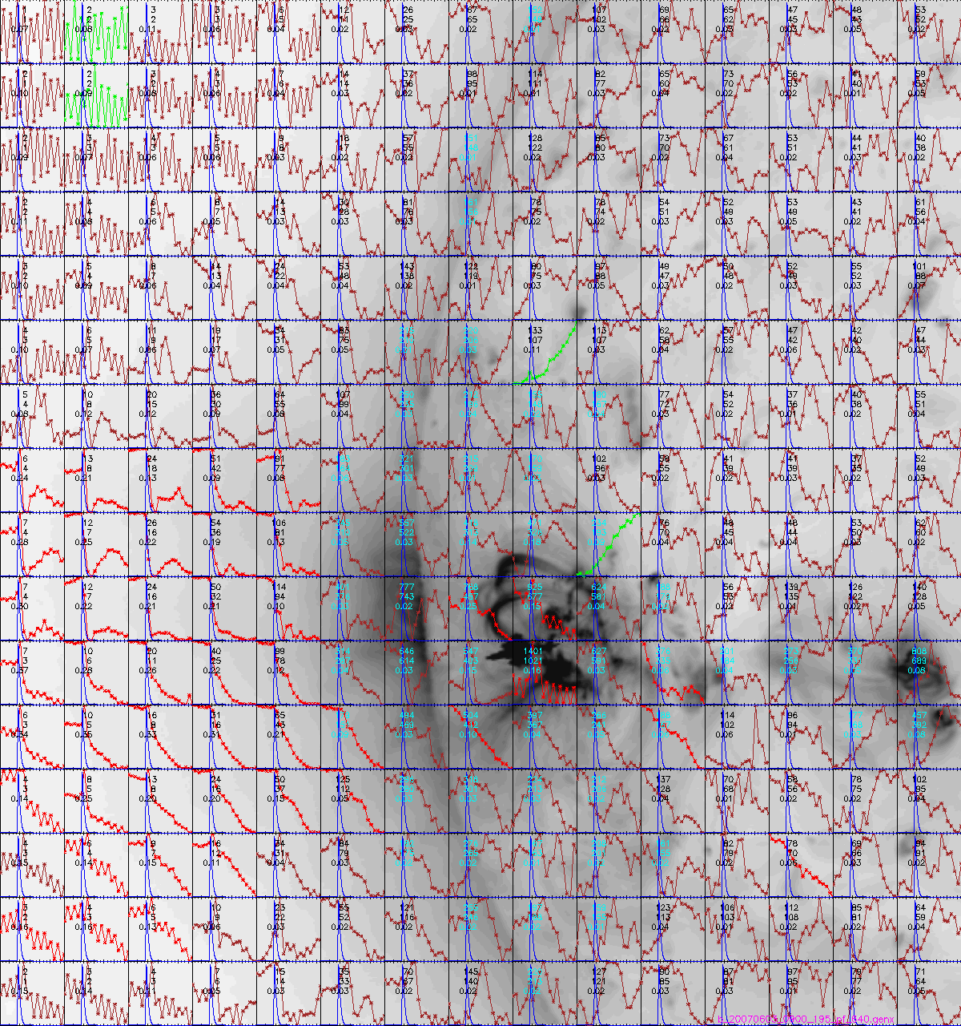
Dimming light curves in macro pixels
Use macro pixels consisting of 40x40 full resolution pixels from co-registered maps
171 Å
195 Å

Slide 18
Dimming and CME
Since the CME is a large-scale phenomenon, it is expected that the associated dimming is also large-scale.
A flare-associated CME is observed if there are >10 macro pixels that show decrease in flux by more than 10%, starting around the flare onset. This has to be met at least at 171 Å and 195 Å. It is sometime seen at 284 Å and even at 304 Å.
Dimming areas at different wavelengths are not necessarily co-spatial, and the recovery times may also be different.
Dimming less extended and shallower can be due to confined ejection, loop expansion, heating/cooling or other phenomena as a result of active region evolution.
But this rule of thumb may not apply to CMEs not associated with a flare.

Slide 19
Conclusions
Majority of the relatively ``large’’ flares during the minimum between cycle 23 and cycle 24 are not associated with CMEs.
Most of these confined flares occurred in active regions with cycle 23 polarity, although with high non-potentiality indices.
The C-class flare producing regions in 2009 (AR 11024, 11026 and 11029) had new cycle polarity.
There are only a handful of flare-associated CMEs that may possibly be heliospherically significant (e.g., several from AR 10956 [May 2007], 2007/12/31, 2008/01/02, 2008/03/25, 2008/04/26, etc.). Many spectacular CMEs are not associated with flares.
Apart from the early evolution of AR 10956 during which a few notable CMEs occurred, the regions that were responsible for the above flare-associated CMEs were minor.
Coronal dimming is a good indicator of the occurrence of a flare-associated CME and its properties if it is extensive and deep enough.

