Slide 1
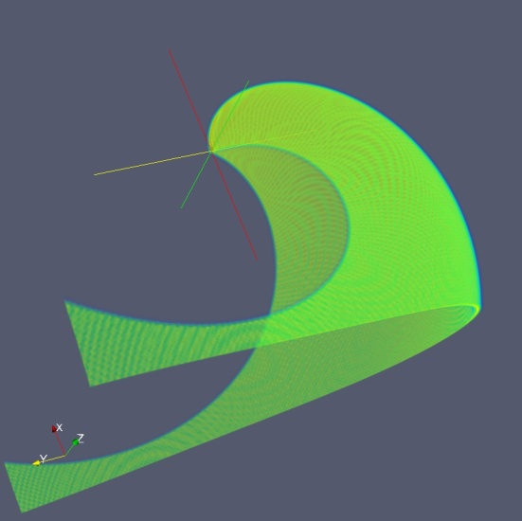
An Empirical 3-D Reconstruction of a CIR: The 2008 January 31 CIR example (Wood et al. 2009, ApJL, submitted)
HI2-A
HI2-B
3D CIR model
Synthetic HI2-A image
Synthetic HI2-B image

Slide 2
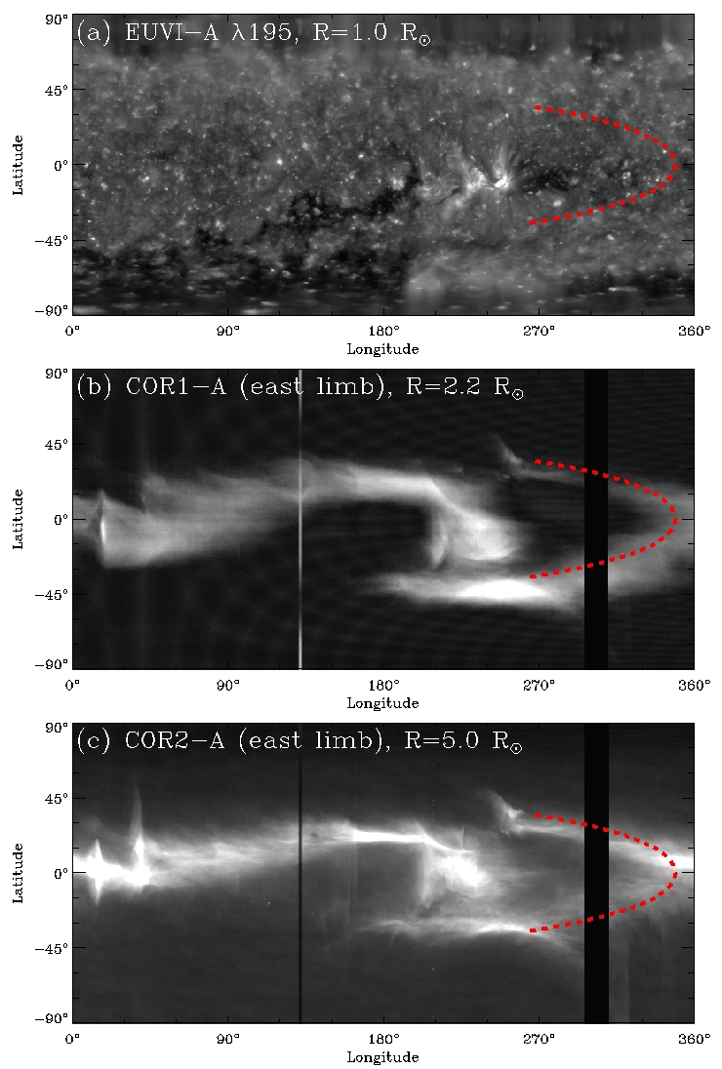
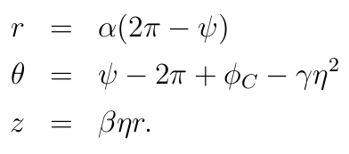
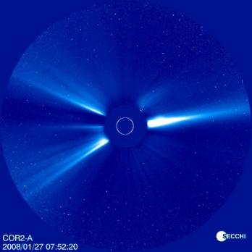
Building a 3-D CIR
The following equations define the shape of a 2-D CIR shape in cylindrical coordinates in 3-D space, where ψ∈[0,2π] and η∈[-1,1].
A 3-D density distribution is then derived by assuming a Gaussian density profile normal to the 2-D CIR shape, such that if δ(r,θ,z) is the distance of a point from the CIR midplane, then
For our morphological purposes, we simply set n_{max}=1. For the 2008 January 31 CIR, our best fit has the following parameters:
This CIR maps back to a bifurcated streamer near the Sun, which surrounds a coronal hole (see right).
α = 0.802 AU/rad
ϕ_{C} = 6.091 rad
β = 0.7
γ = 1.48 rad
σ_{n} = 0.0098 AU

Slide 3
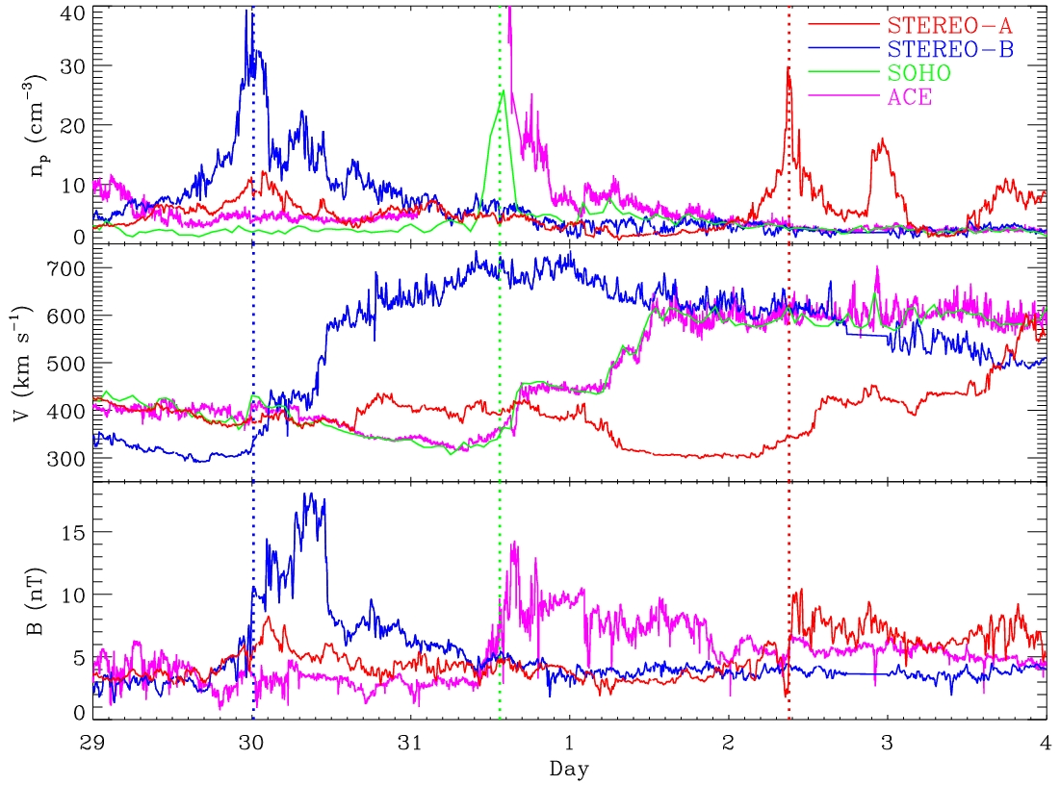
In Situ Observations of the 2008 Jan. 31 CIR
The curvature of the model CIR can be related to the velocity of the slow wind barrier against which fast wind is impinging by:
This equation yields V_{eff}=345 km/s, consistent with the observed velocity at the time of the CIR density pulse (see right).
The duration of the CIR density pulse (particularly at STEREO-B) can be related to the CIR model parameters via:
This equation yields Δt=0.15 days, roughly consistent with the observed density pulse (see right).
2008 January
2008 February

